Slide 1
Swale’s Playbook for Place –
Dominant Strategy

Slide 2
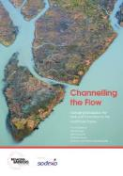
BBI History
Launch of the Breaking Barriers Innovations Playbook
June 2016
Feb 2017
June 2018
March 2018
May 2018
Sept 2018
Nov 2018
April 2019
June 2019
June 2019
May 2020
July 2020
Sept 2020
Oct 2020

Slide 3
The Playbook
Playbook
Stakeholders
Building Blocks
Barriers
Aims
The Goal
Local Government
NHS CCGs, Trusts & GPs
Short Term Priorities
Place-based approach that delivers
Housing Associations
No Blueprint
Residents & Third Sector
Different Systems
Education Providers
Siloed Budgets
Central Government
Fear & Risk of Failure
Social / Private Sector Housing

Slide 4
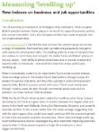
Playbook
NHS Long Term
Plan (2019)
HEE Topol Review (2019)
Covid Recovery
plan
Levelling up
strategy
1
Sector Leaders
NHS CCGs
Health and Wellbeing Boards
Sustainability and Transformation Partnerships
Integrated Care Partnerships
Local Authorities
Strategic Alignment
2
Agree Dominant Strategy
1
Evidence-based, not ideological
3
Translation into culture and practice
4

Slide 5
The Playbook
Playbook
Strategic Alignment
Agree Dominant Strategy
1

Slide 6
The Playbook
Playbook
Inclusion and empowerment
Resident & Community Engagement
1
Co-Design
2
Sustainability
2
Strategic Alignment
Community support
Agree Dominant Strategy
1
3

Slide 7
The Playbook
Playbook
Resident & Community Engagement
Co-Design
2
Strategic Alignment
Agree Dominant Strategy
1

Slide 8
The Playbook
Playbook
Resident & Community Engagement
Co-Design
2
Recruitment and retention
1
Strategic Alignment
Learning networks /
cross-professional
2
Agree Dominant Strategy
1
Skills ladders and competency based learning
Workforce for the future
Skills, Competence, & Culture
3
3

Slide 9
The Playbook
Playbook
Resident & Community Engagement
Co-Design
2
Strategic Alignment
Agree Dominant Strategy
1
Workforce for the future
Skills, Competence, & Culture
3

Slide 10
The Playbook
Playbook
Resident & Community Engagement
Co-Design
2
Strategic Alignment
Agree Dominant Strategy
1
Workforce for the future
Skills, Competence, & Culture
3
Service Integration
Service Transformation
4

Slide 11
The Playbook
Playbook
Action Plan
Co-designed with
service users
1
Resident & Community Engagement
Co-Design
2
Workforce and skills plan
2
Innovation and learning
from industry and CVS
Strategic Alignment
3
Agree Dominant Strategy
1
Workforce for the future
Skills, Competence, & Culture
Affordable & sustainable
4
3
Service Integration
Service Transformation
Governance route map
4
5

Slide 12
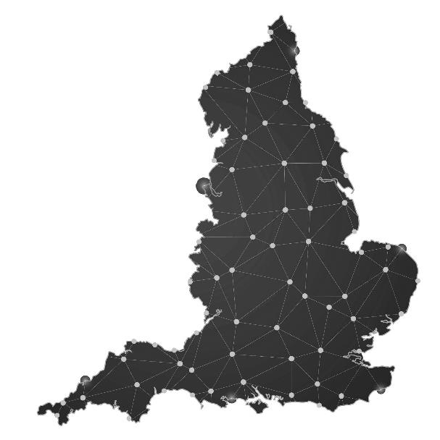
Programmes
Hampshire and Isle of Wight
Somerset
West Yorkshire
Suffolk and North East Essex
Cornwall and Isles of Scilly
Kent (Swale)
South East London

Slide 13
Swale’s Playbook for Place
1
3
2
Context, challenges, and consequences
Enabling policies and programmes
Agree place-based approach
Co-production
Opportunities
Life Science
Swale Playbook Programme
Coastal Economy
Regeneration and development
Sheerness Ports

Slide 14
1
Framing the Dominant Strategy for Swale
Focus
Inquiry
1
Which challenges present the biggest barrier to improving life outcomes for the residents of Swale?
a
SBC strategic documentation
KCC and DfE Community Engagement Programme
b
c
HEE: Rural & Coastal Transformation
2
What interventions are best suited to a system approach as opposed to traditional siloed activity?
d
NHSE/I Health Inequalities Programme
e
Levelling Up Whitepaper
f
30 x interviews with anchor organisations

Slide 15
1
Context, Challenges, Consequences
Intra-Borough Disparities
Context
Consequences
Challenges
Learning from Lockdown
Recruitment and retention
Skills and education
Infrastructure and investment

Slide 16
1
Context, Challenges, Consequences
Intra- Borough Disparities
“I would say the borough is fractured, that’s exactly how I’d describe it”
Ward | Very Good Health (%) | Very Bad Health (%)
Sheerness (Sheppey) | 38.9 | 2
Sheppey Central (Sheppey | 43.2 | 1.5
Sheppey East (Sheppey) | 34.6 | 2.6
Homewood (Sittingbourne) | 45.7 | 1
Boughton and Courtenay (Faversham) | 48.7 | 1
Pre-pandemic figures (ONS, 2019) as part of KCC strategic commissioning analysis (2019)
UK Average is 53%

Slide 17
1
Context, Challenges, Consequences
Intra- Borough Disparities
“the borough is fractured”
Ward | Very Good Health (%) | Very Bad Health (%)
Sheerness (Sheppey) | 38.9 | 2
Sheppey Central (Sheppey | 43.2 | 1.5
Sheppey East (Sheppey) | 34.6 | 2.6
Homewood (Sittingbourne) | 45.7 | 1
Boughton and Courtenay (Faversham) | 48.7 | 1
Pre-pandemic figures (ONS, 2019) as part of KCC strategic commissioning analysis (2019)
UK Average is 53%

Slide 18
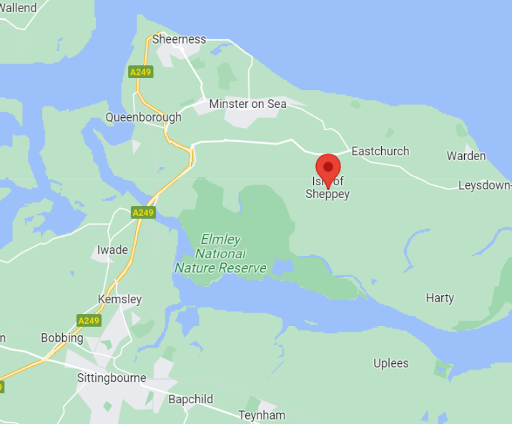
1
Context, Challenges, Consequences
12 miles. 8.3 years difference in life expectancy*
Intra- Borough Disparities
Life expectancy in Sheerness West: 75.5
For every mile travelled
life expectancy is 255 days less
Life expectancy in Woodstock: 83.8
*female life expectancy

Slide 19
1
Context, Challenges, Consequences
Intra- Borough Disparities
“the borough is fractured”
Ward | Economically inactive (%) | Unemployed (%)
Sheerness (Sheppey) | 37.3 | 8.5
Sheppey Central (Sheppey | 30 | 4.3
Sheppey East (Sheppey) | 48.8 | 5.5
Homewood (Sittingbourne) | 28.1 | 3.9
Boughton and Courtenay (Faversham) | 30.2 | 2.5
Pre-pandemic figures (ONS, 2019) as part of KCC strategic commissioning analysis (2019)
On average, 21% of those living in the UK report to be economically inactive

Slide 20
1
Context, Challenges, Consequences
Intra- Borough Disparities
“the borough is fractured”
Ward | Economically inactive (%) | Unemployed (%)
Sheerness (Sheppey) | 37.3 | 8.5
Sheppey Central (Sheppey | 30 | 4.3
Sheppey East (Sheppey) | 48.8 | 5.5
Homewood (Sittingbourne) | 28.1 | 3.9
Boughton and Courtenay (Faversham) | 30.2 | 2.5
Pre-pandemic figures (ONS, 2019) as part of KCC strategic commissioning analysis (2019)
On average, 21% of those living in the UK report to be economically inactive

Slide 21
1
Context, Challenges, Consequences
Learning from Lockdown
Public Services Responded Well
a
Clarity of thinking
“The pandemic gave us a real focus... People were listening and then doing”
b
Speed of action
“The best outcome from COVID was that it took away barriers”
c
Partnership working
“Swale Borough Council have been particularly helpful and supportive during the pandemic, ensuring access to resources and support “

Slide 22
1
Context, Challenges, Consequences
Learning from Lockdown
Swale’s Lockdown
Sheppey East ward peaked at 2,079 cases per 100,000 people- nine times the UK average
Higher levels of workforce in manual and prison based jobs unable to work from home
Poorer quality housing meant adequate ventilation become more challenging
Over 1,000 children traveling off the island every day
Lockdown highlighted centrality of employment to health outcomes in the Borough

Slide 23
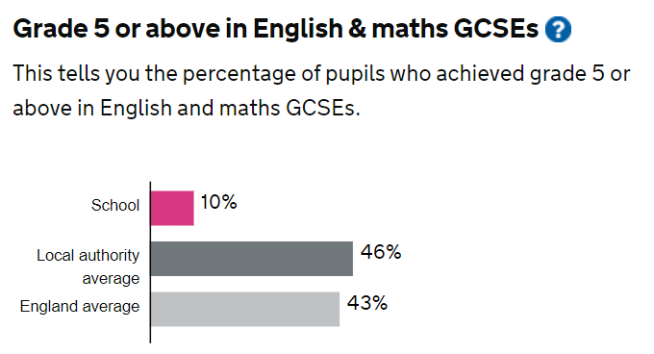
1
Context, Challenges, Consequences
Skills and education
In some schools, 90% of students are leaving without sufficient Level 3 skills
Level 2-3 skills creates access into good, sustainable employment
Oasis Academy
Swale borough

Slide 24
1
Context, Challenges, Consequences
Skills and education
Qualification levels for jobs are rising
The Kent and Medway Workforce Skills Evidence Base 2021 - by 2027
Proportion of the workforce requiring a degree is expected to increase by 6%
Proportion requiring qualifications at level 1 or below will fall 5%
“There is a skills gap with Swale and Sheppey with a much lower level 3 attainment than the rest of the county”.

Slide 25
1
Context, Challenges, Consequences
Recruitment and retention
Across Kent, 83,800 working in health and social care but with significant vacancies (7,000) & skills gaps
GP recruitment – worst performing 1% in country (Swale)

Slide 26
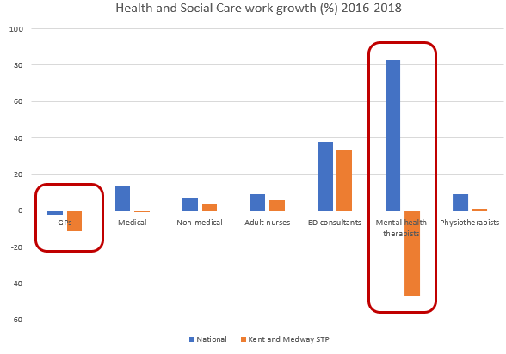
1
Context, Challenges, Consequences
Recruitment and retention
Local trends are unsustainable and therefore a critical system priority

Slide 27
1
Context, Challenges, Consequences
Recruitment and retention
Across Kent & Medway the picture is positive- net annual workforce demand is over 28,000 FTEs with significant numbers in high value roles including:
3,100 business associates
4,100 corporate managers
1,500 science, engineering and tech roles
Significant opportunity for improving Swale’s population health if these jobs are accessible by local residents

Slide 28
1
Infrastructure and Investment
Infrastructure and Investment
Transport
59% of Sheppey’s workforce commute off island
Housing
By 2038, 25.3% of homes will require an adaption to deal with health and care demands
Digital exclusion
Only 41% of households in Kent reach UK national average connection speeds

Slide 29
1
Context, Challenges, Consequences
Intra-Borough Disparities
Context
Consequences
Challenges
Learning from Lockdown
Recruitment and retention
Skills and education
Infrastructure and investment

Slide 30
1
3
2
Context, challenges, and consequences
Enabling policies and programmes
Agree place-based approach
Co-production
Opportunities
Life Science
Swale Playbook Programme
Coastal Economy
Regeneration and development
Sheerness Ports

Slide 31
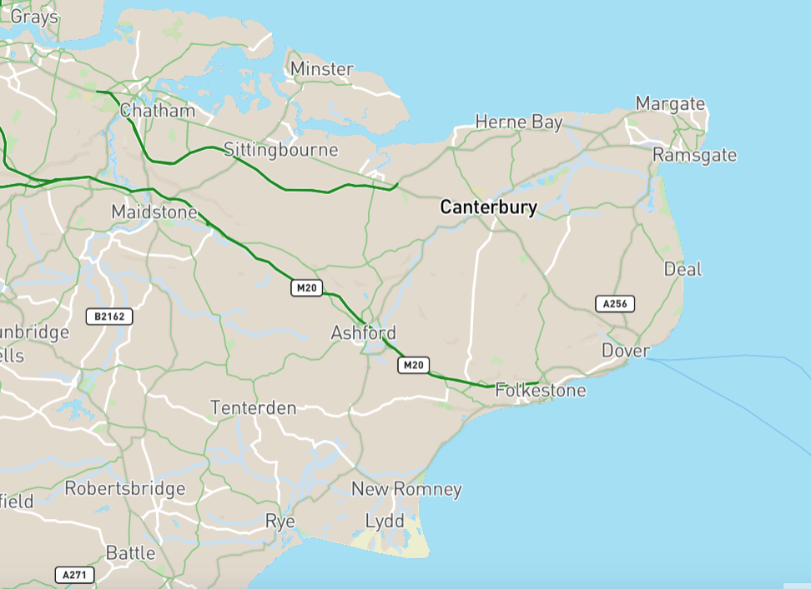
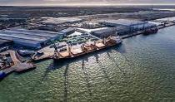
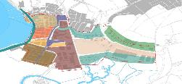
2
Sheerness Ports
3
1
Health & Life Sciences
1
Regeneration & Development
Coastal Economy
4

Slide 32
2
Opportunities
Science Park
Some of the world’s most innovative companies are located in Kent Science Park
Health &
Life Sciences
30mins Sheerness East
Medical school
Kent and Medway medical school represents opportunity to increase Swale-grown talent pipeline especially into primary care
55mins Sheerness East
Diagnostic Centre
Local recruitment opportunity in Swale diagnostic hub

Slide 33
2
Opportunities
Construction Manager
Development of amenities and apartments to create nearly 800 jobs in construction and logistics
Regeneration and Development
Logistics Operator
Engineers
Electrician
Inward investment of £330 million into Sittingbourne over the next decade
Team Leaders
Architect
Queenborough and Rushenden – Homes England project 1,100 new dwellings additional 400 jobs
Project Manager
Surveyors
Plumber

Slide 34
2
Opportunities
On Island opportunity
Sheerness Ports
The Port has limited relationships with key partners in education, skills and health services
Peel Port’s 20 year master plan for developing high-paying, long-term careers
Expected demand will rise 130% over the next 20 years creating additional footfall into the borough
Planned multi-million pound investment by Volkswagen to create 150 new supply chain jobs

Slide 35
2
Opportunities
Elmney Nature reserve
Thames Estuary
Coastal Economy
On Island opportunity
Pan-Regional Opportunity
Planned creation of 1.3m jobs in south east – “the UK’s number one growth opportunity”
“Swale is a marketeers dream” Private Investor
3,300-acre nature reserve and hospitality space
Part of Government’s ‘Green Blue Action Plan’
Commitment to tackling inequalities through local economic growth
Bringing 20,000 – 25,000 visitors a year

Slide 36
2
Sheerness Ports
3
1
1
Regeneration & Development
Life Sciences
Coastal Economy
4

Slide 37
2
Opportunities
Health &
Life Science
Regeneration and Development
Sheerness Ports
Coastal Economy
Pipeline of diverse, good quality sustainable jobs on the horizon
However, recruitment and retention issues in existing sectors (i.e. NHS) indicate we need to start preparing the community for these jobs now

Slide 38
1
3
2
Context, challenges, and consequences
Enabling policies and programmes
Agree place-based approach
Co-production
Opportunities
Life Science
Swale Playbook Programme
Coastal Economy
Regeneration and development
Sheerness Ports

Slide 39
3
Policies and Programnmes
Policy/ Programme
Key organisations
Objectives
CMO Report
DHSC
Understand the drivers of health disparities in coastal communities
KCC and DfE Community Engagement Programme
KCC and DFE
Improve educational outcomes on the Isle of Sheppey
Levelling Up
SBC
Address geographical disparities in economic, social, and cultural outcomes
HEE Rural and Coastal Communities Programme
HEE
Improve workforce development pathways in rural and coastal areas
NHSE/I Health Inequalities Programme
NHSE/I
Tackle health inequalities

Slide 40
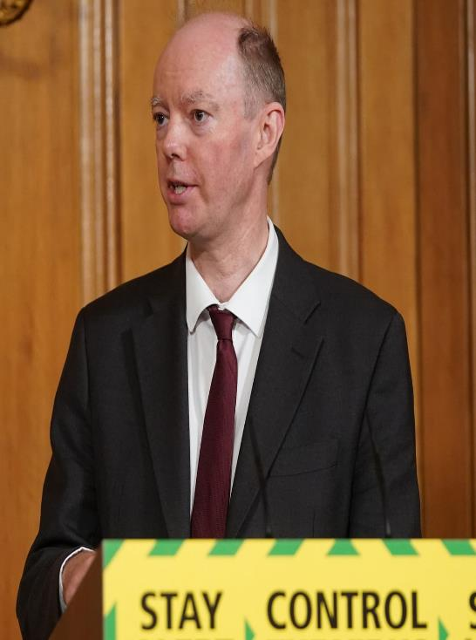
The timing for this programme is critical as coastal communities are under the national spotlight.
The CMO report acknowledges the unique challenges faced by coastal communities across health and wellbeing.

Slide 41
Coastal Communities: Key findings
a
Higher burden of disease across a range of conditions i.e. heart disease
b
Higher levels of deprivation
c
Higher burden of mental ill-health i.e. youth self-harm
d
Demographic challenges i.e. elderly population and subject to increases in migrant populations
e
These challenges affect workforce recruitment and retention relating to medical professions

Slide 42
Key recommendations
Cross-government national strategy to improve health and wellbeing of coastal communities
a
Address the mismatch between health and social care worker
deployment
b
Improve data gathering and actionable research for coastal communities
c

Slide 43
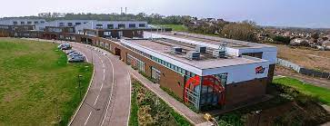
3
Policies and Programmes
KCC and DfE Community Engagement Programme
Objective
Community engagement model aimed at improving education outcomes on the Isle of Sheppey

Slide 44
3
Policies and Programmes
KCC and DfE Community Engagement Programme
Enablers/ Activity
Active engagement of parents and carers
Employers
Education (FE & HE) and skills providers

Slide 45
3
Policies and Programmes
Levelling Up
Objectives (National)
Boost productivity, pay, jobs and living standards
Spread opportunities and improve public services
Restore a sense of community, local pride and belonging
Empower local leaders and communities

Slide 46
3
Policies and Programmes
Levelling Up
Enablers (Local) - £20m bid
Regenerate Sheerness
i.e. leisure offer and potentially health
Expanding Sheppey College
Extending the offer at Master’s House

Slide 47
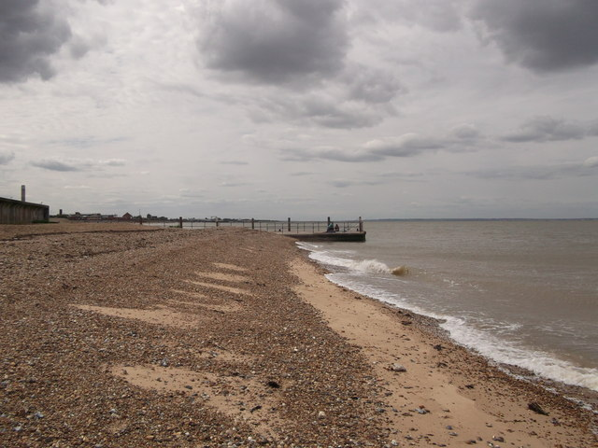
3
Policies and Programmes
HEE Coastal and Rural Communities
Objectives
Maximise impact of current education & training provisions
Review methods of recruitment, training and skills development
Ensure continuous improvement of the workforce in coastal communities
Collaborate with partners across education, training and skills development

Slide 48
3
Policies and Programmes
HEE Coastal and Rural Communities
Potential Enablers
Dental Workforce – Advancing Dental Care
Medical Education Reform Programme
Future Doctor Programme
Generalist Schools

Slide 49
3
Policies and Programmes
NHS Inequalities
Objective: Address Health Inequalities on 20% most deprived communities
Core20PLUS:
Population Groups
Clinical Focus Areas
Core20
CVD
Cancer
Mental health
PLUS
Maternity
Respiratory

Slide 50
3
Policies and Programmes
NHS Inequalities
NHS Anchors Progrannme Enablers
Procurement
Estates
Workforce
Digital

Slide 51
3
Policies and Programmes
NHS Inequalities
Enablers
Digital
Digital exclusion is a recognised form of inequality
Close correlation between digital exclusion and social disadvantages including lower income, lower levels of education, and poor housing
Better digital access can increase access to health services

Slide 52
1
3
2
Context, challenges, and consequences
Enabling policies and programmes
Agree place-based approach
Co-production
Opportunities
Life Science
Swale Playbook Programme
Coastal Economy
Regeneration and development
Sheerness Ports

Slide 53
4
The Dominant Strategy
Digital
Provide equitable access to opportunity
Mobility
Alignment

Slide 54
4
The Dominant Strategy
Alignment
1
Take opportunities forward?
How do…
2
Address challenges?
Digital
3
Align with policy?
Mobility

Slide 55
4
The Dominant Strategy
Building Block 1: Alignment Between Employers, Education, Skills and Training
Education
Skills
Workforce
Employer Needs

Slide 56
4
The Dominant Strategy
Health and Care Academy Clacton Case Study
Supported by HEE and the Integrated Care System
Supporting NHS recruitment, but also teaching skills, which are transferable across all sectors
Senior (16-18) cohorts
Bespoke learning interventions for the Junior (14-16) audience
Providing young under-achievers in Tendring with opportunities to expand their horizons

Slide 57
4
The Dominant Strategy
Alignment
By working with parents, carers, and students we will gain a wider understanding of the challenges they are facing
1
Take opportunities forward?
2
By including the groups as part of the co-production process it provides them with a sense of purpose and motivation
Address challenges?
3
Align with policy?

Slide 58
4
The Dominant Strategy
Alignment
1
Take opportunities forward?
A programme of engagement with KCC and DfE to focus on improved education outcomes needs to consider the important of aligning with skills and workforce needs in the borough
2
Address challenges?
3
Align with expansion of Sheppey College via the Levelling Up bid
Align with policy?

Slide 59
4
The Dominant Strategy
Building Block 2: Digital
Inform digital interventions i.e: apprenticeship through lived experience of residents including most at risk communities

Slide 60
4
The Dominant Strategy
Digital
Digital advances can bring opportunities closer quicker
1
Take opportunities forward?
Virtual apprenticeships are an accessible and affordable way to bridge the gap from education to employment
2
Address challenges?
This cannot be designed in a lab. Courses need to be targeted and tailored for the circumstances of at risk groups
3
Align with policy?

Slide 61
4
The Dominant Strategy
Only 41% of households in Kent reach UK national average connection speeds
Digital
1
Take opportunities forward?
59% of Sheppey’s workforce presently travel off the island-
New hybrid working models would keep more residents on the island, increasing work life balance and local economy
2
Address challenges?
3
Align with policy?

Slide 62
4
The Dominant Strategy
Digital
HEE Coastal and Rural Communities Paper recognises a lack of digital literacy as a “significant threat to development”
1
By 2030, the UK aims to have nationwide gigabit-capable
broadband and 4G coverage through the Shared Rural Network
Take opportunities forward?
2
Address challenges?
UK National Academy – an online education and skills service designed to open up access for skills development to school students
3
Align with policy?

Slide 63
4
The Dominant Strategy
Mobility
1
Transport and mobility recognised as a key cause of geographical disparities nationally and locally
Take opportunities forward?
2
Address challenges?
3
Align with policy?

Slide 64
4
The Dominant Strategy
Building Block 3: Mobility
Through co-production inform how levelling up and wider transport investments can connect residents to off-shore employment and vice versa
Test appetite for innovative approaches ie: employer supported transport initiatives that connect communities to major employment centres

Slide 65
4
The Dominant Strategy
Mobility
Off-island employment opportunities and the means of accessing them need to be included within the plan (Science Park, Thames Estuary, Medical School)
1
Take opportunities forward?
2
Address challenges?
3
Align with policy?

Slide 66
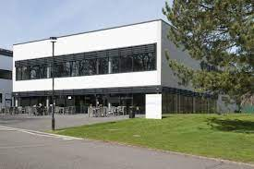
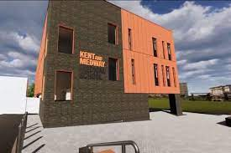
4
The Dominant Strategy
Mobility
Better transport and mobility will increase access not only to employment but health and skills
1
Take opportunities forward?
Science Park
Medical school
2
Address challenges?
30mins Sheerness East
55mins Sheerness East
3
Align with policy?

Slide 67
1
3
2
Context, challenges, and consequen-ces
Enabling policies and programmes
Agree place-based approach
Co-production
Opportunities
Life Science
Swale Playbook Programme
Coastal Economy
Regeneration and development
Sheerness Ports

Slide 68
5
Swale Playbook Programme
Health, education and economy are indivisible challenges for Swale
Digital
Opportunities to address these challenges
Mobility
Focus on coastal communities means national and local anchors are proactively looking to support the solution
Alignment
Levelling Up and wider economic generation is generating a long term, high value sustainable employment pipeline
System focus needs to be upon

Slide 69
Building Blocks
Stakeholders
Parents & carers
Parent and carer attitudes to work are a significant influence on young people with respect to education and skills development
Digital
Workforce
Use the experience of the current workforce to identify challenges and opportunities to improve recruitment and retention
Mobility
Alignment
Employers
Connect skills requirements from employment clusters ie: Science Park, NHS, Port
HEE, NHSE, KCC, SBC
Anchors
Consider and design interventions

Slide 70
Building Blocks
Stakeholders
Parents & carers
Digital
1
Health and Care Academy
Workforce
Mobility
2
Digital interventions
Alignment
Employers
Levelling Up & transport
3
Anchors

Slide 71
Building Blocks
Stakeholders
Building Blocks
Parents & carers
Outline business case for Health and Care academy that will be focal point for relevant transferable skills and how it will work with schools, employment clusters and community to align with Sheppey College
1
Digital
Workforce
Mobility
2
Inform digital interventions i.e: apprenticeship through lived experience of most at risk communities
Employers
Alignment
Anchors
3
Align levelling up and wider transport interventions to focus on employment and the island of swale

Slide 72
5
Swale Playbook Programme
Digital
Potential Programme Partners: SBC, KCC, NHSE & HEE
Equitable access to skills, competencies & opportunity
Mobility
Alignment

Slide 73
5
Co-Production
Design
Co-production & Evaluation
Delivery

Slide 74
5
Why we need action now
8 years life expectancy disparity between wards in Swale
By taking the right action at a place level we can significantly address health and life outcomes for Swale residents
Health and Care staffing levels are unsustainable
Impact of Lockdown on school children where already
90% not achieving 5 GCSE qualifications
Coordination of existing programmes- and establish a national cross-sector pathfinder for coastal communities
Cross Government national strategy for coastal communities

