Slide 1
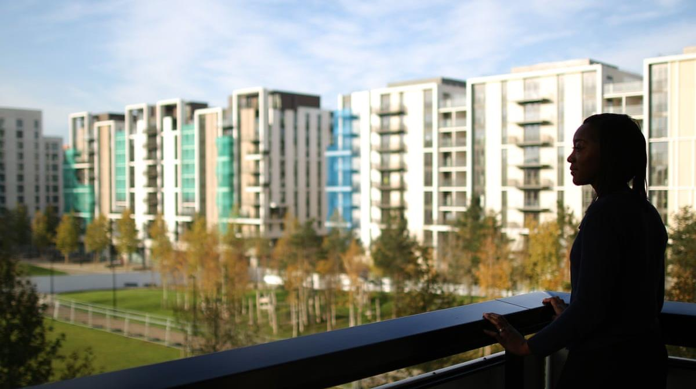
LEARNING FROM LOCKDOWN
Lessons for Healthy Housing and New Settlements

Slide 2
Background
Formation of BBI
2015
Overcoming paradox of place

Slide 3
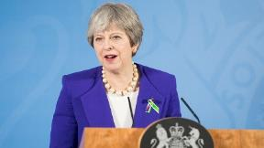
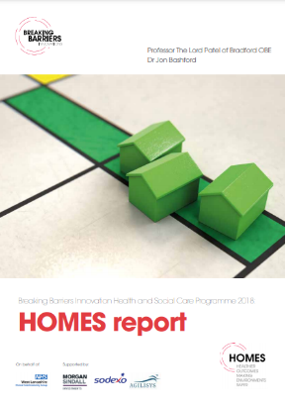
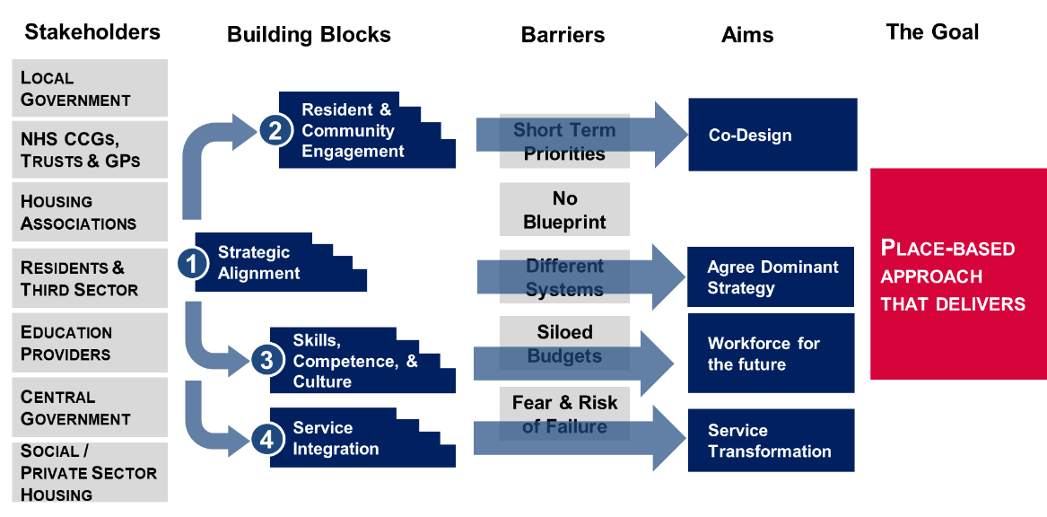
Background
Playbook for Place
2015
2018
Overcoming paradox of place
Housing as a key determinant of health and wellbeing

Slide 4
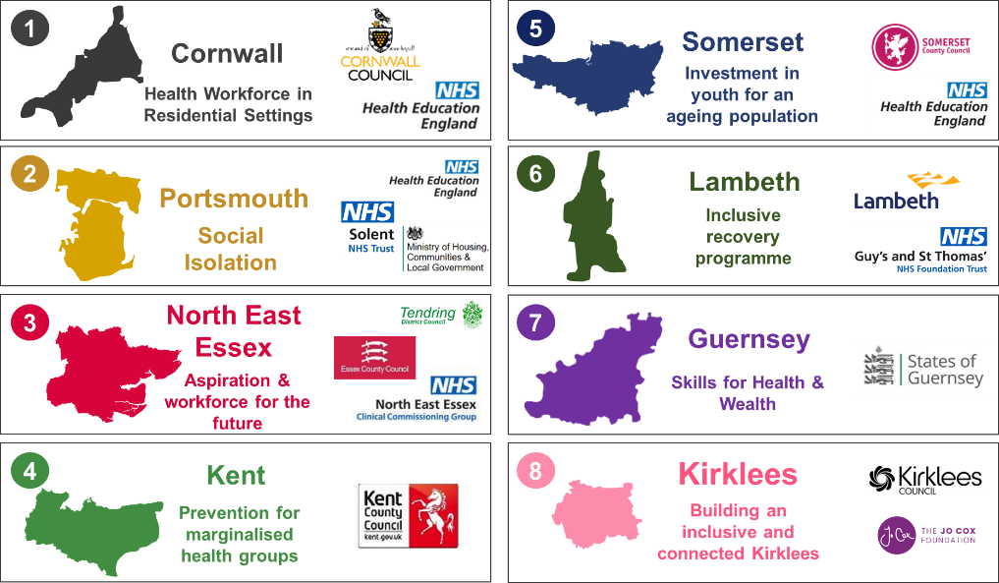
Background
Pilot locations
2015
2018
2019 – 21
Overcoming paradox of place
Housing as a key determinant of health and wellbeing

Slide 5
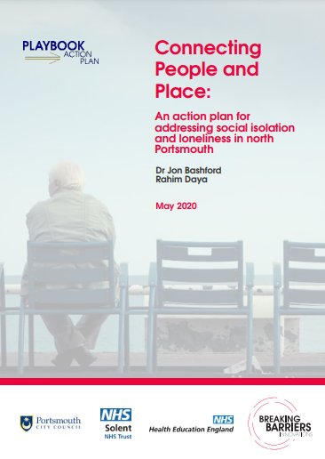
Background
Portsmouth Playbook
Functional approaches
Structural approaches
Befriending services
Support groups
Bereavement counselling
Day centres
Received health and care services e.g. mental health, addictions, etc.
Safeguarding and family conferencing
Neighbourhood design
Breakfast clubs
Faith groups
Sports and recreation
Employment
Volunteering
Civic participation
Social media
Men in sheds

Slide 6
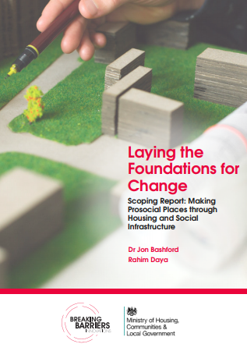
Laying the Foundations report
Laying the Foundations report

Slide 7
Laying the Foundations report
Through lens of:
Initial stakeholder
engagement
Places
People
Our plan
1
Conceptual framework for quality
1
Rural
1
Define
1
Cross-generational
2
Coastal
Framework for cross disciplinary competency and skills
2
Design
2
Senior living
Culturally dead places
2
3
3
Deliver
2
Diverse
needs

Slide 8
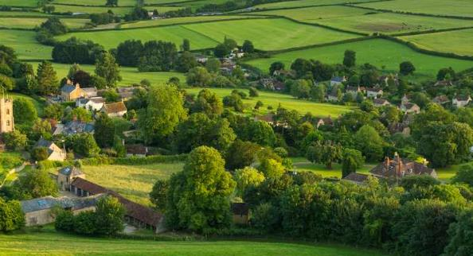
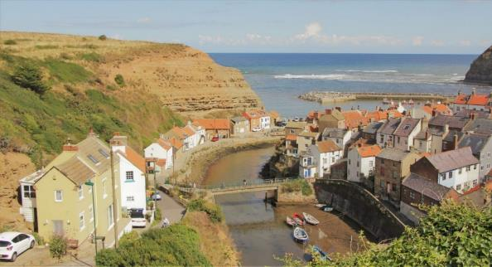
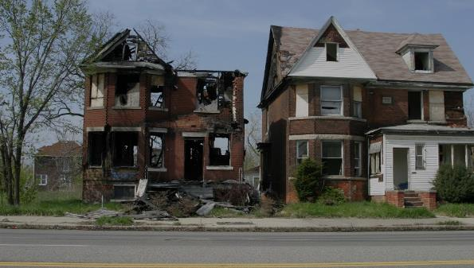
Laying the Foundations report
Rural
Coastal
Culturally dead places
Inaccessible and poor digital infrastructure
Lack of investment leading to high rates of deprivation
No cultural or distinctive
place making features
Combination of all three

Slide 9
Laying the Foundations report
Through lens of:
Initial stakeholder
engagement
Places
People
Our plan
1
Conceptual framework for quality
1
Rural
1
Define
1
Cross-generational
2
Coastal
Framework for cross disciplinary competency and skills
2
Design
2
Senior living
Culturally dead places
2
3
3
Deliver
2
Diverse needs

Slide 10
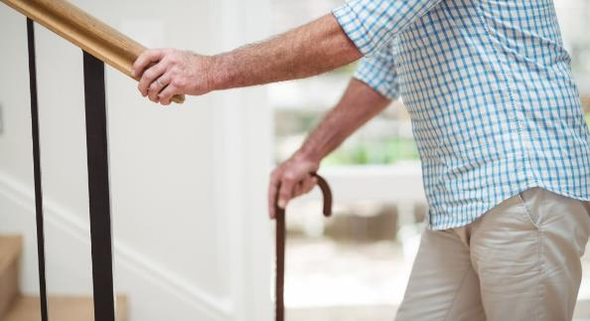
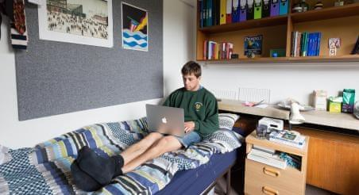
Laying the Foundations report
Cross-generational
Senior living
Diverse needs
Loneliness wrongly perceived as elderly challenge
At same time, not sufficiently addressing senior living needs
Plan for environments that enable all communities to thrive ie: student, learning disabilities, etc.

Slide 11
Laying the Foundations report
Through lens of:
Initial stakeholder
engagement
Places
People
Our plan
1
Conceptual framework for quality
1
Rural
1
Define
1
Cross-generational
2
Coastal
Framework for cross disciplinary competency and skills
2
Design
2
Senior living
Culturally dead places
2
3
3
Deliver
2
Diverse needs

Slide 12
Laying the Foundations report
Conceptual framework for quality
1
Evidence and data
7
Measure social value
2
Promoting grassroots
8
Whole-system
3
Transport links
9
Building resilience
4
Neighbours
10
Digital interventions
5
Cohousing
11
Employment opps
6
Micro-funding
12
Evaluation

Slide 13
Laying the Foundations report
Conceptual framework for quality
1
Evidence and data
7
Measure social value
Role of anchors is fundamental
2
Promoting grassroots
8
Whole-system
3
Transport links
9
Building resilience
4
Neighbours
10
Digital interventions
5
Cohousing
11
Employment opps
6
Micro-funding
12
Evaluation

Slide 14
Laying the Foundations report
Through lens of:
Initial stakeholder
engagement
Places
People
Our plan
1
Conceptual framework for quality
1
Rural
1
Define
1
Cross-generational
2
Coastal
Framework for cross disciplinary competency and skills
2
Design
2
Senior living
Culturally dead places
2
3
3
Deliver
2
Diverse needs

Slide 15
Laying the Foundations report
Cross-disciplinary competencies framework
1
Local Development Plan
7
Vitality of town centres
2
Neighbourhood planning
8
Healthy & safe communities
3
Engaging Developers
9
Sustainable transport
4
Tailoring planning controls
10
Quality communications
5
Sufficient supply of homes
11
Appropriate densities
6
Building strong economy
12
Well-designed places

Slide 16
Laying the Foundations report
Cross-disciplinary competencies framework
1
Local Development Plan
7
Vitality of town centres
Planning siloed from health and social care in most cases
2
Neighbourhood planning
8
Healthy & safe communities
3
Engaging Developers
9
Sustainable transport
4
Tailoring planning controls
10
Quality communications
5
Sufficient supply of homes
11
Appropriate densities
6
Building strong economy
12
Well-designed places

Slide 17
Laying the Foundations report
Initial stakeholder
engagement
Places
People
Our plan
1
Conceptual framework for quality
1
Rural
1
Define
Younger generations left behind
1
2
Coastal
Framework for cross disciplinary competency and skills
2
Design
Elderly need not tailored towards
Dead places
2
2
3
3
Deliver

Slide 18
Laying the Foundations report
Initial stakeholder
engagement
Places
People
Our plan
Moving forward
1
Conceptual framework for quality
1
Rural
1
Define
Report focused on planned settlements but existing housing stock is the greater challenge
Lockdown has provided significant opportunities to learn
Younger generations left behind
1
2
Coastal
Framework for cross disciplinary competency and skills
2
Design
Elderly need not tailored towards
Dead places
2
2
3
3
Deliver

Slide 19
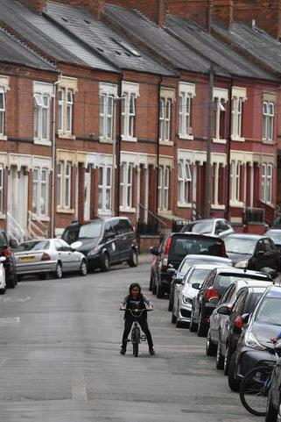
Learning from lockdown
Emerging evidence on impact of Covid-19
Overcrowded, damp, unsafe homes have worsened the spread of COVID-19, and may have contributed to higher death rates in poorer areas.
1
2
Poorer resilience in neighbourhoods with low levels of digital literacy and connectivity
Learnt the value of hyper local services i.e. 99% of those living in deprived areas can access community pharmacies within 20 mins
3

Slide 20
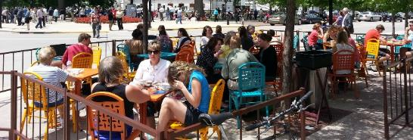
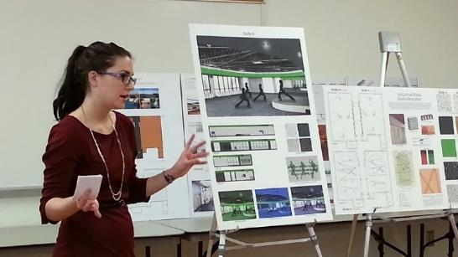
Proposed 2021-22 programme
Use playbook programme to drive momentum in 2 – 3 key locations
1
Model of co-production to be used nationwide
2
Share learning to inform MHCLG and NHS national policy at key time
3

Slide 21
Discussion points to inform programme
Has lockdown fundamentally changed the approach to the design and delivery of existing housing and new settlements? Or are the dynamics elastic?
1
What is the appetite for using community engagement (not consultation) and place to drive design and delivery of housing agendas?
2
Are we building meaningfully upon elements from the levelling up agenda, NHS long term plan, and education reform to inform the way forward?
3

Slide 22
Learning from Lockdown Roundtable
Breaking Barriers Innovations hosted a roundtable event on 29th June 2021 chaired by David Orr CBE, former Chief Executive of the National Housing Federation, and attended by over 20 housing, planning, public health, and NHS representatives from the organisations below:
Essex County Council
Staffordshire County Council
Somerset County Council
Teignbridge District Council
London Borough of Havering Council
Lancashire Teaching Hospitals NHS Foundation Trust
Exeter Council
HACT
Runnymede Borough Council
Exeter City Council
Lincolnshire County Council
British Red Cross
Campaign to End Loneliness
Public Health England
NHS Solent Trust
Northumbria Healthcare NHS Foundation Trust
Norfolk County Council

Slide 23
Learning from Lockdown Roundtable
Breaking Barriers Innovations hosted a roundtable event on 29th June 2021 chaired by David Orr CBE, former Chief Executive of the National Housing Federation, and attended by over 20 housing, planning, public health, and NHS representatives from the organisations below:
The following slides are a thematic review of anonymised comments from the day and BBI analysis of what this means going forward
Essex County Council
Staffordshire County Council
Somerset County Council
Teignbridge District Council
London Borough of Havering Council
Lancashire Teaching Hospitals NHS Foundation Trust
Exeter Council
HACT
Runnymede Borough Council
Exeter City Council
Lincolnshire County Council
British Red Cross
Campaign to End Loneliness
Public Health England
NHS Solent Trust
Northumbria Healthcare NHS Foundation Trust
Norfolk County Council

Slide 24
We cannot generalise the impact that lockdown has had – those who can’t work from home have had a more challenging time in some respects
Massive rise in need for single dwelling properties for people with complex needs
The new definition of middle class is that you can work from home
People in retail who have lost their jobs or been furloughed have spent most of their time at home – huge impact on them
Unequal impact of lockdown

Slide 25
We cannot generalise the impact that lockdown has had – those who can’t work from home have had a more challenging time in some respects
Massive rise in need for single dwelling properties for people with complex needs
The new definition of middle class is that you can work from home
People in retail who have lost their jobs or been furloughed have spent most of their time at home – huge impact on them
Lessons from lockdown, particularly around employment need to be sourced from multiple experiences
Unequal impact of lockdown

Slide 26
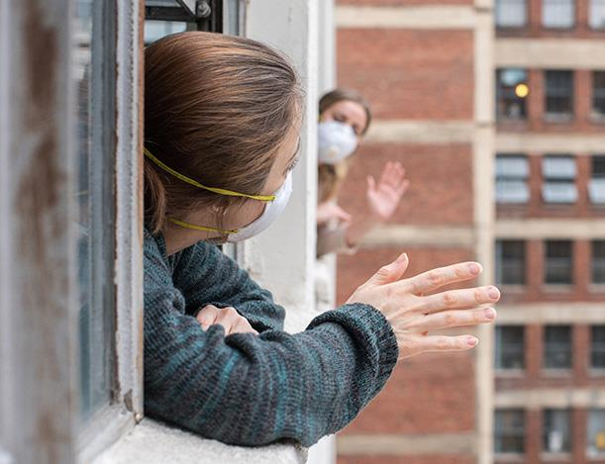
There have been changes in travel patterns and how people spend their leisure time which has meant that some people have able to spend more time with their communities and families during the lockdown
20% of pubs have permanently closed and the loss of community infrastructure for people to bump into each other has made it harder to be social and to connect
Places with strong social connections have been better able to manage consequences of lockdown
Street WhatsApp groups and meeting neighbours when clapping for carers – is this a moment in time or will some these connections be cemented?
Loneliness and lockdown

Slide 27
There have been changes in travel patterns and how people spend their leisure time which has meant that some people have able to spend more time with their communities and families during the lockdown
20% of pubs have permanently closed and the loss of community infrastructure for people to bump into each other has made it harder to be social and to connect
Places with strong social connections have been better able to manage consequences of lockdown
Street WhatsApp groups and meeting neighbours when clapping for carers – is this a moment in time or will some these connections be cemented?
Neighbourhood planning needs to take stock of what community assets have been lost/ weakened during lockdown. Also examine those assets that have been strengthened/ emerged
Loneliness and lockdown

Slide 28
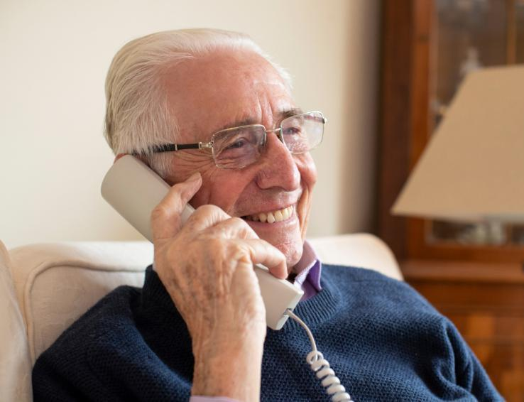
During the lockdown, housing associations sought to contact over-70s and vulnerable people and these people were so pleased to have someone reach out. This is an example of a small thing that can make a massive impact that hadn’t been done previously.
The pandemic has shown that services can be delivered in a different way rather than only speaking with tenants when they are in crisis or when they want something
Changing relationships between tenants and HAs/LAs

Slide 29
During the lockdown, housing associations sought to contact over-70s and vulnerable people and these people were so pleased to have someone reach out. This is an example of a small thing that can make a massive impact that hadn’t been done previously.
The pandemic has shown that services can be delivered in a different way rather than only speaking with tenants when they are in crisis or when they want something
Measure the long-term value of maintaining contact with elderly and vulnerable tenants
Changing relationships between tenants and HAs/LAs

Slide 30
Rapid digitisation can be a risk or an opportunity depending on the community
Recognising issues around digital connectivity and cost of data, one housing association hired a van to drive around an estate to allow people to connect to the internet
Virtual community hub allows people to find out about local services. Workshops, coffee mornings, and other ways of getting together virtually are offered through the app as well through relationships with the voluntary sector
Tackling the digital divide is important but can’t take away from creating opportunities for face to face interactions that we know are better for people to meaningfully connect
Risks and opportunities of digital connectivity

Slide 31
Rapid digitisation can be a risk or an opportunity depending on the community
Recognising issues around digital connectivity and cost of data, one housing association hired a van to drive around an estate to allow people to connect to the internet
Virtual community hub allows people to find out about local services. Workshops, coffee mornings, and other ways of getting together virtually are offered through the app as well through relationships with the voluntary sector
Tackling the digital divide is important but can’t take away from creating opportunities for face to face interactions that we know are better for people to meaningfully connect
Balance efforts to tackle digital poverty with renewed focus on bringing back face to face interactions
Risks and opportunities of digital connectivity

Slide 32
Climate change is the single biggest global challenge we face when it comes to building homes fit for the future
The need for retrofitting to decarbonise our homes creates an opportunity to think more broadly about how we can improve the quality of existing homes
Huge financial challenge but huge commercial benefits to be realised that haven’t been properly conveyed
Covid and COP26 presents an opportunity for systematic and large scale change
Need to speed up movement away from car-orientated environments
Decarbonisation and climate change

Slide 33
Climate change is the single biggest global challenge we face when it comes to building homes fit for the future
The need for retrofitting to decarbonise our homes creates an opportunity to think more broadly about how we can improve the quality of existing homes
Huge financial challenge but huge commercial benefits to be realised that haven’t been properly conveyed.
Covid and COP26 presents an opportunity for systematic and large scale change
Need to speed up movement away from car-orientated environments
From a neighbourhood planning perspective, post-lockdown learning and COP 26 planning should be fully aligned
Decarbonisation and climate change

Slide 34
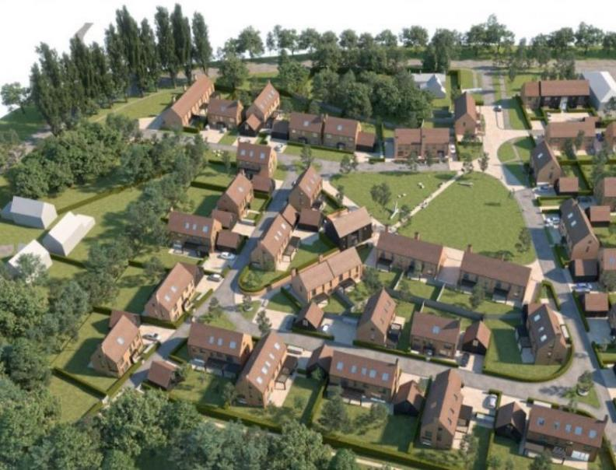
What people want is not unreasonable (somewhere leafy where kids can play outside, one can go for a walk easily, access shops, restaurants, leisure and culture activities) but is beyond what is affordably on offer at present
Developers’ focus is on the first customer – they have no real interest in how a place develops over time. How can better designed places create more value for developers?
Issues emerging in some rural communities around affordability as low paid workers privately renting are being made homeless as landlords convert homes into holiday lets
Changing demands must be reflected in new housing and retrofiting of existing settlements
Reasonable demands for where people want to live

Slide 35
What people want is not unreasonable (somewhere leafy where kids can play outside, one can go for a walk easily, access shops, restaurants, leisure and culture activities) but is beyond what is affordably on offer at present
Developers’ focus is on the first customer – they have no real interest in how a place develops over time. How can better designed places create more value for developers?
Issues emerging in some rural communities around affordability as low paid workers privately renting are being made homeless as landlords convert homes into holiday lets
Changing demands must be reflected in new housing and retrofiting of existing settlements
Comprehensively move away from the “first customer” approach to new neighbourhoods
Reasonable demands for where people want to live

Slide 36
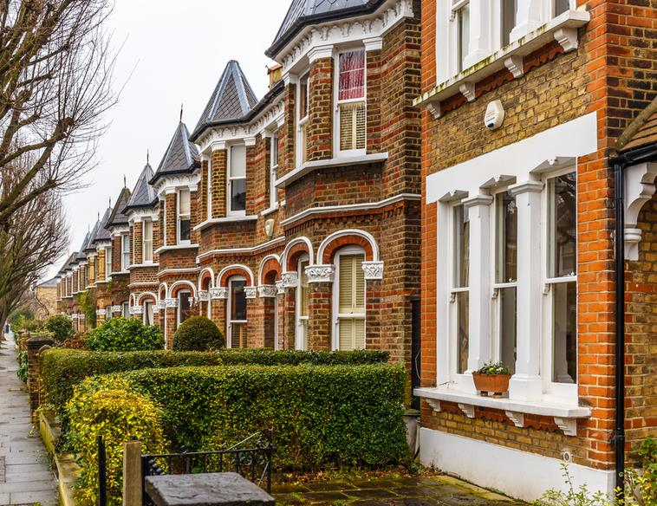
Housing market is hottest in suburban areas on outskirts of towns and cities – demonstrating a movement of people out of cities toward increasingly valuing their surrounding environment. I think most people want to live in suburbia.
Do most people want to live in suburbia? Or do most people want to live in homes that are affordable, good quality, in communities where they feel safe, secure, and where they can realise their ambitions for them, their families and their children? This could be suburbia for some, and for others it might not be.
Differing views on suburbia

Slide 37
Failing to recognise the huge potential of communities to solve their own problems
Failing to resource communities to do what they do best in their own way
System/decision makers self-reinforcement of consultation as engagement
Engaging the usual suspects instead of asking why others are not joining in
Short termism in commissioning, programmes, project thinking, and funding the limits ability for communities to take ownership
Use of language that is unknown and not shared by local community e.g. levelling up reform
Failing to understand it is expensive to be poor
Seven sins for engagement from Exeter City Council

Slide 38
Failing to recognise the huge potential of communities to solve their own problems
Failing to resource communities to do what they do best in their own way
System/decision makers self-reinforcement of consultation as engagement
Engaging the usual suspects instead of asking why others are not joining in
Short termism in commissioning, programmes, project thinking, and funding the limits ability for communities to take ownership
Use of language that is unknown and not shared by local community e.g. levelling up reform
Failing to understand it is expensive to be poor
Ensure we understand what we mean by good quality community engagement and the benefits it brings
Seven sins of engagement from Exeter City Council

Slide 39
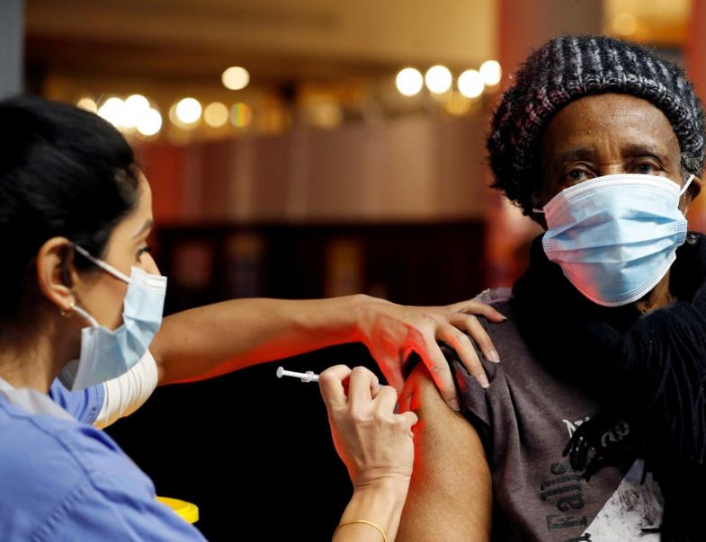
The NHS is now talking about themselves as an anchor institution, talking about health inequalities, and community development in ways they never have in the past
NHS colleagues been surprised by how health inequalities in their area have been exacerbated by the pandemic – the impact of overcrowding, poor housing, digital poverty on health
Can’t be complacent about moment in time to press for change
Our city established a cross-sectoral place board who created a shared 2040 vision for the city. At the heart of the vision is healthy and inclusive communities. If the council had tried this, it wouldn’t have the same buy-in
Levers for change

Slide 40
The NHS is now talking about themselves as an anchor institution, talking about health inequalities, and community development in ways they never have in the past
NHS colleagues been surprised by how health inequalities in their area have been exacerbated by the pandemic – the impact of overcrowding, poor housing, digital poverty on health
Cant be complacent about moment in time to press for change
Our city established a cross-sectoral place board who created a shared 2040 vision for the city. At the heart of the vision is healthy and inclusive communities. If the council had tried this, it wouldn’t have the same buy-in
Capitalise on increased awareness in the NHS of the importance of good quality housing to deliver more ambitious projects
Levers for change

Slide 41
Unequal impact of lockdown
Loneliness and lockdown
Changing relationships with tenants
Risks and opps of digital connectivity
Decarbonisation and climate change
Reasonable demands for where to live
Differing views on suburbia
Seven sins of engagement
Levers for change

Slide 42
Lessons from lockdown, particularly around employment need to be sourced from multiple experiences
Neighbourhood planning needs to take stock of what community assets have been lost / weakened during the lockdown
Examine those assets that have been strengthened / emerged from the lockdown
Measure the long-term value of maintaining contact with elderly and vulnerable tenants
Balance efforts to tackle digital poverty with renewed focus on bringing back face to face interactions
From a neighbourhood planning perspective, post-lockdown learning and COP 26 planning should be fully aligned
Comprehensively move away from the “first customer” approach to new neighbourhoods
Ensure we understand what we mean by good quality community engagement and the benefits it brings
Capitalise on increased awareness in the NHS of the importance of good quality housing to deliver more ambitious projects

Slide 43
Lessons from lockdown, particularly around employment need to be sourced from multiple experiences
Neighbourhood planning needs to take stock of what community assets have been lost / weakened during the lockdown
Examine those assets that have been strengthened / emerged from the lockdown
BBI want to build from the work to date to see how we can improve neighbourhood planning in light of the lockdown experience by working with up to 3 parallel locations over the next 10 months
Measure the long-term value of maintaining contact with elderly and vulnerable tenants
Balance efforts to tackle digital poverty with renewed focus on bringing back face to face interactions
From a neighbourhood planning perspective, post-lockdown learning and COP 26 planning should be fully aligned
Comprehensively move away from the “first customer” approach to new neighbourhoods
Ensure we understand what we mean by good quality community engagement and the benefits it brings
Capitalise on increased awareness in the NHS of the importance of good quality housing to deliver more ambitious projects

Slide 44
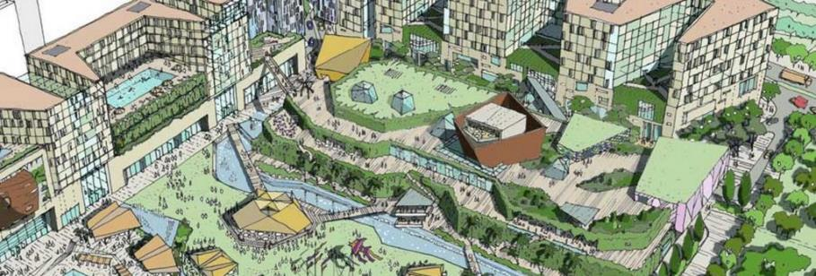
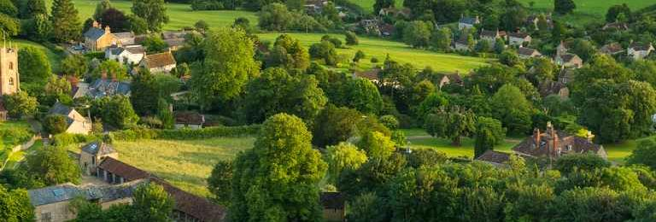
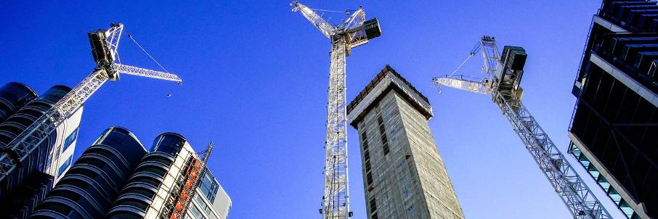
Who we want to work with
Locations with ambitious plans and a desire to use a place based approach
Rural locations with poor digital connectivity and transport connections
Locations with understanding of why acting now prevent costs
Urban communities navigating challenges around commercial investment trade offs

Slide 45
Who we want to work with
Locations with ambitious plans and a desire to use a place based approach
Rural locations with poor digital connectivity and transport connections
Locations with a vision but requiring greater partnership working to co-design with local communities, NHS, and VCSE
Locations with understanding of why acting now prevent costs
Urban communities navigating challenges of increased gentrification

Slide 46
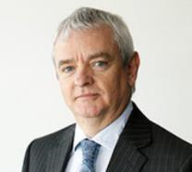
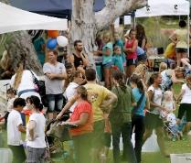
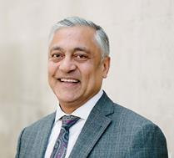
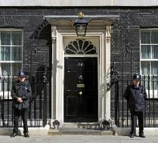
Programme Vision
2 – 3 parallel programmes chaired by David Orr CBE and Lord Patel of Bradford OBE
1
Shared resource model with national and local organisations alongside industry
2
Local momentum and national impact
3

Slide 47
Programme Vision
Systems and organisations
Professional teams
National organisations
Communities

Slide 48
Programme Vision
Systems and organisations
Identify long term dominant strategy, locally that supports all stakeholder plans and goals in health, housing, and economy
Professional teams
National organisations
Co-production of an action plan with system, communities, and professional teams
Communities

Slide 49
Programme Vision
Systems and organisations
Shared and agreed plans for systems and communities
Professional teams
Evaluation framework to enable…
Programme
National organisations
National learning and scaling up
Communities

Slide 50
Next steps
Finalise locations
Playbook for place culminating in agreed action plan informed by evidence base
July 2021
September 2021
April 2022

Slide 51
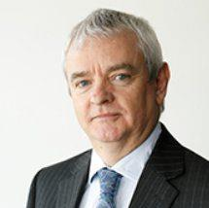
Programme team
David Orr CBE
Professor the Lord Patel of Bradford, OBE
For more details get in touch with Rahim at rahim.daya@bbi.uk.com
Nicholas Werran Partnerships Director
Dr. Jon Bashford
Research Director
Rahim Daya
Programme Manager

