Slide 1





BBI Somerset Playbook:
Overview

Slide 2
The Playbook
Stakeholders
Building Blocks
Barriers
Aims
The Goal
Local Government
NHS CCGs, Trusts & GPs
Short Term Priorities
Place-based approach that delivers
Housing Associations
No Blueprint
Residents & Third Sector
Different Systems
Education Providers
Siloed Budgets
Central Government
Fear & Risk of Failure
Social / Private Sector Housing

Slide 3



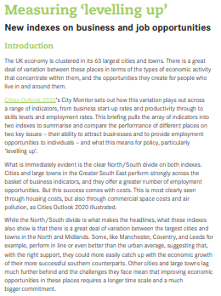
The Playbook
NHS Long Term
Plan (2019)
HEE Topol Review (2019)
Covid Recovery
plan
Levelling up
strategy
1
Sector Leaders
NHS CCGs
Health and Wellbeing Boards
Sustainability and Transformation Partnerships
Integrated Care Partnerships
Local Authorities
Strategic Alignment
2
Agree Dominant Strategy
1
Evidence-based, not ideological
3
Translation into culture and practice
4

Slide 4
The Playbook
Strategic Alignment
Agree Dominant Strategy
1

Slide 5
The Playbook
Inclusion and empowerment
Resident & Community Engagement
1
Co-Design
2
Sustainability
2
Strategic Alignment
Community support
Agree Dominant Strategy
1
3

Slide 6
The Playbook
Resident & Community Engagement
Co-Design
2
Strategic Alignment
Agree Dominant Strategy
1

Slide 7
The Playbook
Resident & Community Engagement
Co-Design
2
Recruitment and retention
1
Strategic Alignment
Learning networks /
cross-professional
2
Agree Dominant Strategy
1
Skills ladders and competency based learning
Workforce for the future
Skills, Competence, & Culture
3
3

Slide 8
The Playbook
Resident & Community Engagement
Co-Design
2
Strategic Alignment
Agree Dominant Strategy
1
Workforce for the future
Skills, Competence, & Culture
3

Slide 9





The Playbook
Action Plan
Co-designed with
service users
1
Resident & Community Engagement
Co-Design
2
Workforce and skills plan
2
Innovation and learning
from industry and CVS
Strategic Alignment
3
Agree Dominant Strategy
1
Workforce for the future
Skills, Competence, & Culture
Affordable & sustainable
4
3
Service Integration
Service Transformation
Governance route map
4
5

Slide 10
The Playbook
Resident & Community Engagement
Co-Design
2
Strategic Alignment
Agree Dominant Strategy
1
Workforce for the future
Skills, Competence, & Culture
3
Service Integration
Service Transformation
4

Slide 11


















Active Programmes
1
4
North East Essex
Cornwall
Housing
Aspiration & workforce for the future
2
5
Kent
Portsmouth
Social Isolation
Prevention for marginalised health groups
3
Somerset
6
Guernsey
Investment in youth for an ageing population
Skills for health, wealth,

Slide 12

System Challenge

Slide 13

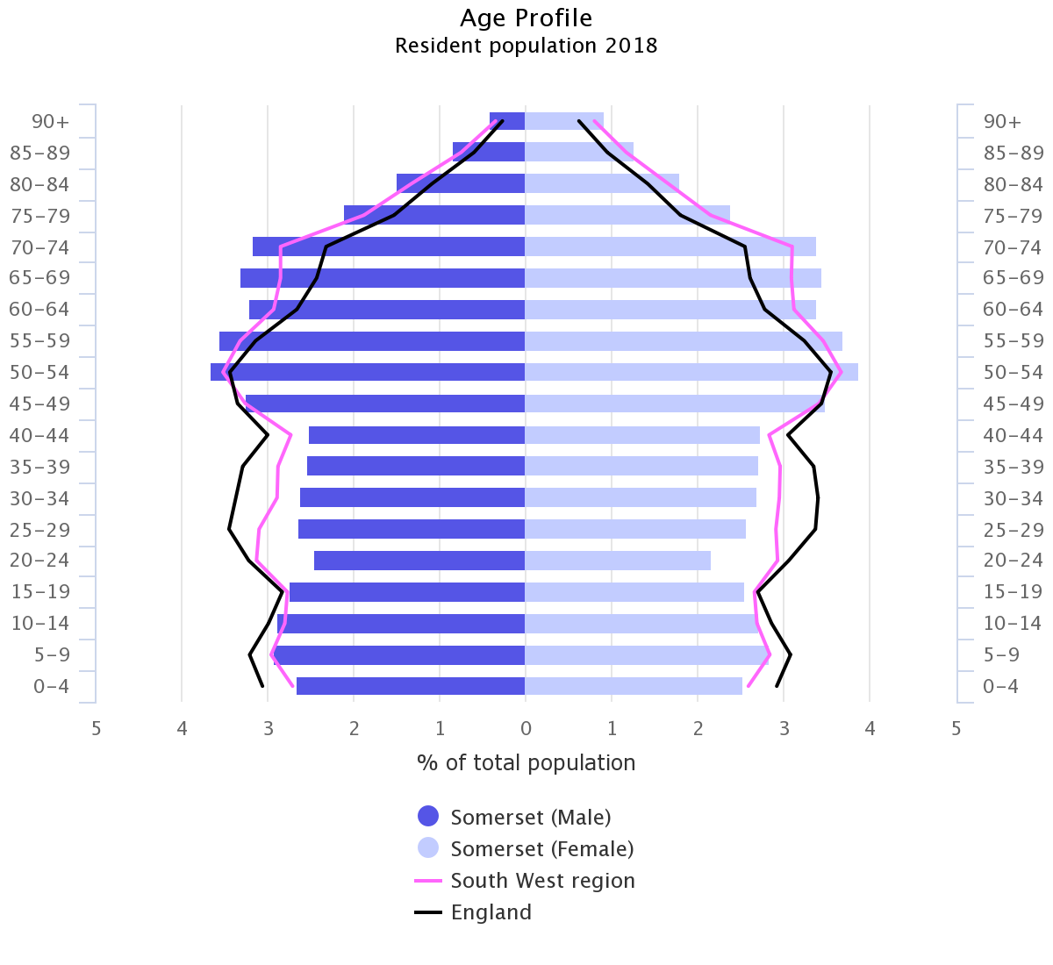
System Challenge: Ageing Pop.
Significantly older than the regional and national average
Those aged 75+ years projected to double in 20 years
In parts of West Somerset, more 50% of population is projected to be aged 65 or older by 2033

Slide 14

System Re-design
System Challenge

Slide 15

System Approach I : Re-design
Context:
Intervention:
Joint working between adult social care, NHS, and voluntary sector on discharges from hospital
NHS savings totalled over £2m and led to 75% reduction in delayed transfers
Half of single-person households are aged 65+

Slide 16

Sustainability Challenges
System Re-design
System Challenge

Slide 17

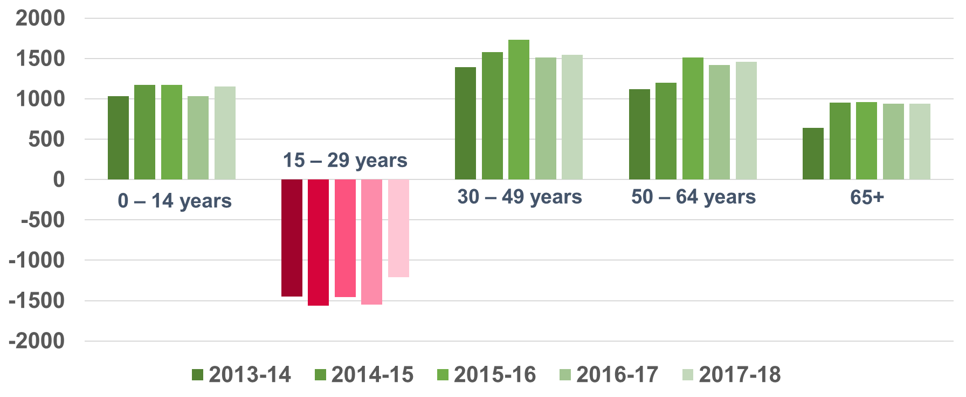
Challenges: Youth net outflow
Youth net outflow unaddressed will significantly exacerbate ageing population challenges irrespective of system redesign efforts

Slide 18
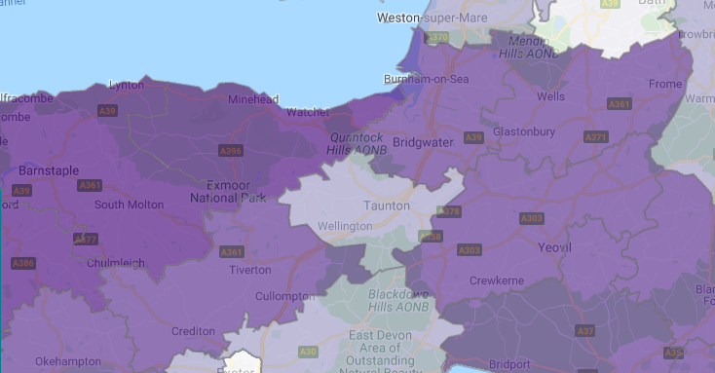
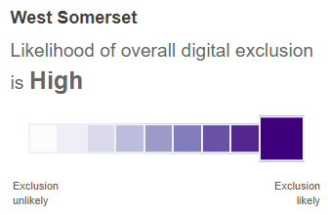
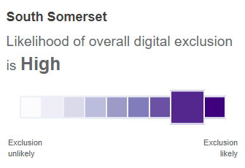
Challenges
: Risk of Digital Exclusion

Slide 19

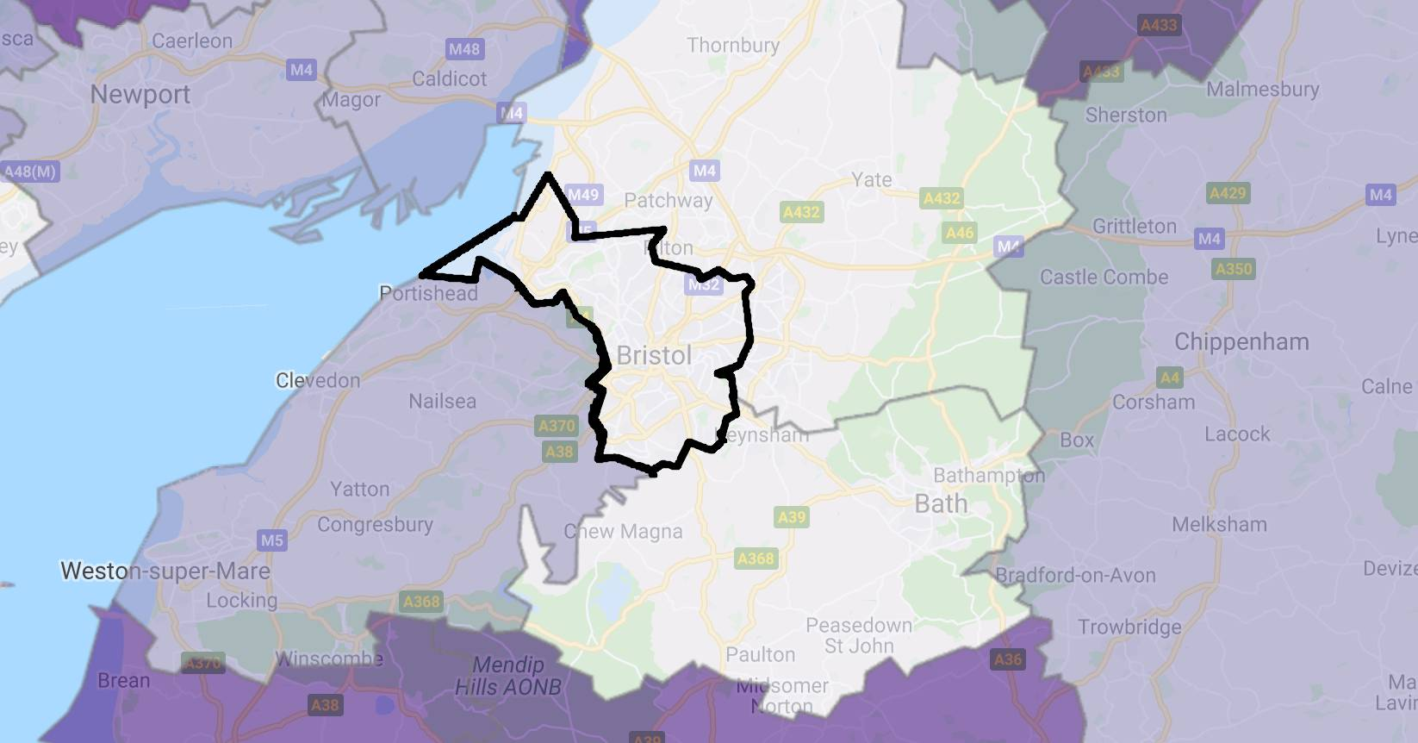
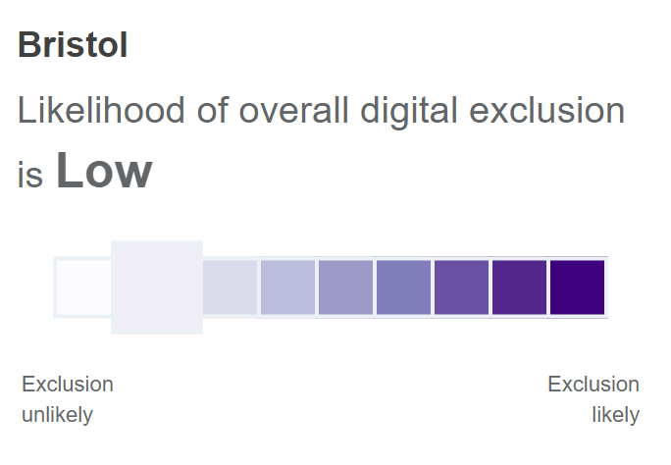
Challenges
: Risk of Digital Exclusion
Bristol
Somerset
Comparison with Bristol digital inclusion

Slide 20
Symptoms
: Workforce shortages
Temporary closure of dementia and community hospital inpatient wards
1
£28m spent on temporary staff and 160 nurse vacancies in year prior to June 2018 for SPFT & TSFT
2
Those wishing to study nursing would have to travel to Bristol which is a challenge from rural Somerset
3

Slide 21
Challenges
: Public Transport

Slide 22
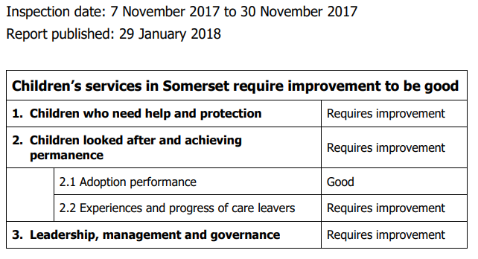
Challenges
: OFSTED
Children’s services were ranked inadequate in 2015

Slide 23

Sustainability Challenges
System Re-design
System Challenge

Slide 24
How can we improve and retain local talent?
Focus & Aims
1
Creating a sustainable trainee pipeline at all levels of competency
2
Consistent approach and career pathway to health and social care apprenticeships
3
Exploring the possibilities of making greater use of further education colleges
4
Developing Somerset as a ‘brand’ to attract recruits to entry level roles

Slide 25

Focus & Aims
Pathway &
Building Blocks
Pathway
Education
Apprenticeships
Volunteering
Digital Inclusion

Slide 26

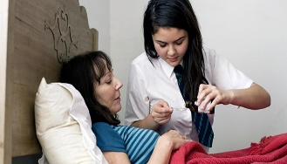
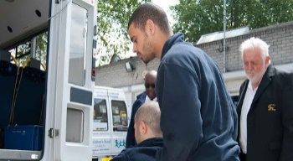

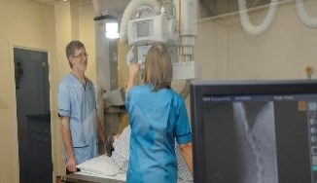



Health and Social Care Pathway for young people
Level of Competence
School Level
Foundation Level 1
Intermediate Level 2
Advanced Level 3
Higher Level 4
Higher Level 5
Higher Level 6
Job Role
Caring for elderly family or those in need
Care Escort
Healthcare Support Worker
Senior Care Supervisor
Residential Care Manager
Education Welfare Officer
Social Worker
Community Transport Driver
Healthcare Assistant
Radiography Assistant
Health Advisor
Nurse Associate
Mental Health Nurse
Volunteer
Porter
Medical Receptionist
Drug & Alcohol Worker
Family Support Worker
Digital performance analyst
Midwife
Health and social care is not usually considered as a career pathway for those interested in digital
Easily accessible jobs for anyone interested in the sector
Notes:
Red line

Slide 27
Health and Social Care Pathway for young people
Level of Competence
School Level
Foundation Level 1
Intermediate Level 2
Advanced Level 3
Higher Level 4
Higher Level 5
Higher Level 6
Skills required
Customer care
Effective comms skills
Use of maths
Leadership
Management
Strategic thinking
Teamwork
Financial skills
Analysis of data
Use of technology
Team lead where appropriate
Effective numerical skills
Simple problem solving
Interpreting data
Complex problem solving

Slide 28
Educational Opportunities for young people
Level of Competence
School Level
Foundation Level 1
Intermediate Level 2
Advanced Level 3
Higher Level 4
Higher Level 5
Higher Level 6
Education Roles and Opps
Health and Care Industrial Centre of Excellence
Vocational courses at FE colleges
Higher Education Diplomas
New local nursing degree programme
Red indicates existing activity
Green indicates suggested actions
T Levels
6th form vocational training
University Centre Somerset (Bridgwater and Taunton College) in partnership with UWE developing local provision of pathways into nursing from level 3 to level 6
Next Steps S. West
Universities take a long time to establish – why wait?

Slide 29
Apprenticeship Opportunities for young people
Level of Competence
School Level
Foundation Level 1
Intermediate Level 2
Advanced Level 3
Higher Level 4
Higher Level 5
Higher Level 6
Apprenticeships
Modern apprenticeships available to 16 – 24 year olds
Health Care Assistant
Pharmacy Technician
Assistant Practitioner
Degree apprenticeships:
Nursing associate higher apprenticeship
Nursing degree apprenticeship
Occupational therapy degree apprenticeship
Nursery Nurse
Dental Nurse
Red indicates existing activity
Green indicates suggested actions
Establishing route from school to pre-registration nursing and mid-wife programmes
Pre-registration nursing programme
Laboratory Support
Advanced Clinical Practitioner apprenticeship
Somerset Partnership NHS Trust apprenticeships and work experience programmes
IT Support
Integrated health and social care apprenticeships and HEE’s Trailblazer Apprenticeships
Apprenticeship Levy
Skills Up & West Somerset Opportunity Area Partnerships Board supporting local businesses
5,000+ apprenticeships offered in the county last year
Notes:
Total number of apprenticeships

Slide 30
Volunteering Opportunities for young people
Level of Competence
School Level
Foundation Level 1
Intermediate Level 2
Advanced Level 3
Higher Level 4
Higher Level 5
Higher Level 6
Volunteering
National Citizen Service
Long Term Plan committed to doubling number of NHS volunteers – opportunities at flu clinics and social prescribing
Serves as first glimpse into sector but currently not easily accessible
Duke of Edinburgh
Prince’s Trust work with HEE to recruit and train those aged 16 – 30 interested in health and social care
Red indicates existing activity
Green indicates suggested actions
2,062 general charities in Somerset with 25% of adults
taking part in formal volunteering once a month
Spark Somerset 2018 recommendations:
Minimise financial costs for volunteers
Develop buddy schemes for new volunteers
Review reward and recognition for volunteers

Slide 31
Digital Inclusion for young people
Level of Competence
School Level
Foundation Level 1
Intermediate Level 2
Advanced Level 3
Higher Level 4
Higher Level 5
Higher Level 6
Digital inclusion
Digital prospects through Skills Up
CCG presence at university fairs to share on digital jobs in NHS
Red indicates existing activity
Green indicates suggested actions
Government essential digital skills framework
TeenTech
Digital Skills Partnership
HEE work on digital literacy through Building a Digital Ready Workforce
LEP’s Connecting Devon and Somerset Superfast Extension Programme
Digital Champions Project
Estimated shortage of NHS workers with data skills: 50,000

Slide 32

Focus & Aims
Pathway &
Building Blocks
Action Plan
Pathway
Education
Apprenticeships
Volunteering
Digital Inclusion

Slide 33
Action Plan Distilled:
Improving & modernising our understanding of the sector
1
2
Developing & retaining workforce
Widening opportunities to contribute through voluntary sector and upgrading digital literacy
3

Slide 34
Reflections from lockdown
1
Cost: Massive resource requirement to support most vulnerable in society
2
Connectivity: Investing in transport, digital and infrastructure is supporting good health care
3
Innovation: Potential and limitations of technology
4
Local vs Central: Place based thinking is not just about the long term but essential in periods of crisis
5
Education: Unless we engage now our biggest lockdown cost will prove to be its impact on children

Slide 35
Summary of activities
5 month actions
Dec 2020
System adoption
Vision Paper
Education provider engagement
Community engagement design
Launch
Event
Government alignment

Slide 36
Education provider engagement
Actions
Outcome
1
Reviewing mapping of current provision
Outlining career pathways, training initiatives, qualifications and opportunities
across organisations
Overview of themes so far:
Issues re: funding for traineeships/apprenticeships
Poor promotion of career pathways
Digital challenges & opportunities
2

Slide 37
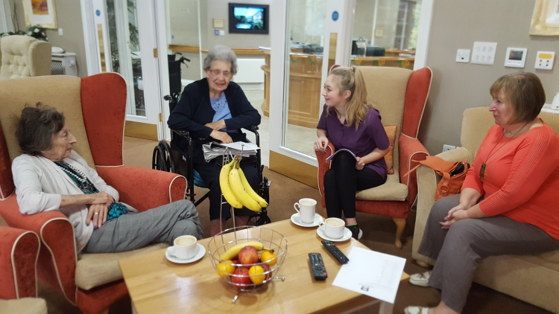
Education provider engagement
Outcome
Outlining career pathways, training initiatives, qualifications and opportunities
across organisations

Slide 38
Community engagement design
Actions
Outcome
1
Working with Spark / Young Somerset to design model:
Fully costed and designed community engagement model ready to implement
Identify how health and social care workforce pathway can meet young people’s needs
Understand the challenges for moving from education into employment
Understanding the NEETs challenges and what support and opportunities they require to consider health and social care careers
Co-designing workforce pathway
2

Slide 39

Community engagement design
Outcome
Fully costed and designed community engagement model ready to implement

Slide 40
Government alignment
Actions
Outcome
Focused inquiry with senior civil CS/ Ministerial teams
Central Government to support;
Funding
Recognition
Structural package
1
MHCLG | DBEIS | DWP | HM Treasury
DfE | DHSC | NHSE/I | Cabinet Office
Education and Skills Funding Agency | Social Mobility Commission | Social Work England | Institute for Apprenticeships and Technical Education
2
Vision Paper that is supported by Govt.

Slide 41
Vision Paper and launch
Actions
Outcome
Informed by local and national senior leaders and education provider feedback
Making the case for change
Kick start implementation phase and secure potential funding commitments
1
Invite senior civil servants to hear about project and get agreement from Minister to open event
2
Perspectives from frontline workforce and young people part of event
3
Notes:
Clacton report cover

Slide 42



System adoption
Outcome
Commitment to integrate work programme into existing relevant business plans through MoUs

Slide 43
System adoption of workforce pathway
Requests for ICS leads
1
Opportunity to present to senior management teams at CCG, NHS Trusts, & LAs
2
Virtual town hall meetings with wider staff input from frontline practitioners
3
Resources and appropriate areas for matched funding locally and nationally
4
Commitment to integrate work programme into existing relevant business plans through MoUs

