Slide 1
Empowering Place-Based Health
Breaking Barriers Winter Review 2019
Review partner:

Slide 2
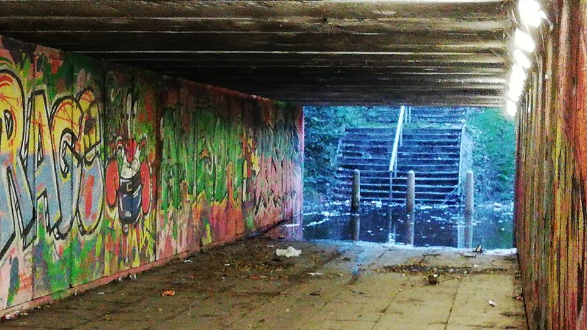
Digmoor Estate, West Lancashire

Slide 3
The Playbook
Resident & Community Engagement
Co-Design
2
Strategic Alignment
Agree Dominant Strategy
1
Workforce for the future
Skills, Competence, & Culture
3
Service Integration
Service Transformation
4

Slide 4
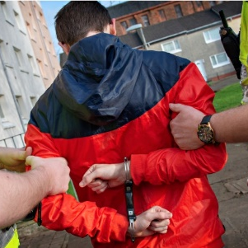
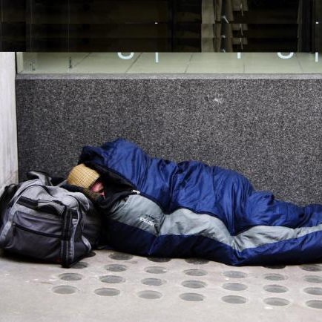
Portsmouth: Family-first approach to tackling social isolation
Exists across the life course
Loneliness is as lethal as smoking 15 cigarettes a day
Children with mental health problems
Youth
drawn
to crime
Young carers
Homeless and rough sleepers
50% higher survival rate from significant health conditions for those socially connected
Disconnected communities could be costing the UK economy £32 billion every year
Social isolation associated primarily with the elderly
Demand on health services: £5.2 billion
Demand on policing:
£205 million
Loss of productivity:
£12 billion

Slide 5
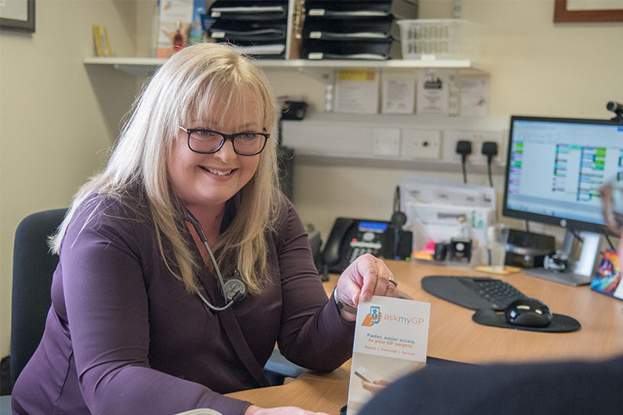
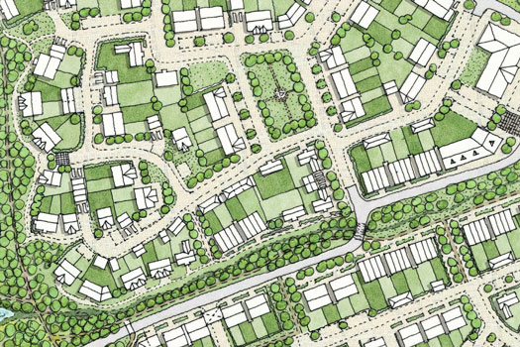
Portsmouth: Family-first approach to tackling social isolation
Functional
Structural
Functional aspects create a buffer against the negative impacts of social isolation and loneliness
Structural aspects promote and sustain the degree of natural social integration
Befriending services
Support groups
Bereavement counselling
Day centres
Received health and care services e.g. mental health, addictions etc.
Safeguarding and family conferencing
Faith groups
Sports and recreation
Employment
Volunteering
Civic participation
Social media
Men in sheds
Notes:
Functional big and structural big

Slide 6
Somerset
In parts of the county, 50% of population will be 65 or older by 2033
Those aged 75+ projected to double in 20 years

Slide 7
Somerset
Ageing Population

Slide 8
Somerset
Joint working between adult social care & NHS has led to 75% reduction in DTOCs
Ageing Population

Slide 9
Somerset
System redesign
Ageing Population

Slide 10
Somerset
Youth Net Outflow
Ageing Population
System redesign
15 – 29 years
0 – 14 years
30 – 49 years
50 – 64 years
65+

Slide 11
Somerset
Youth Net Outflow
Ageing Population
System redesign

Slide 12
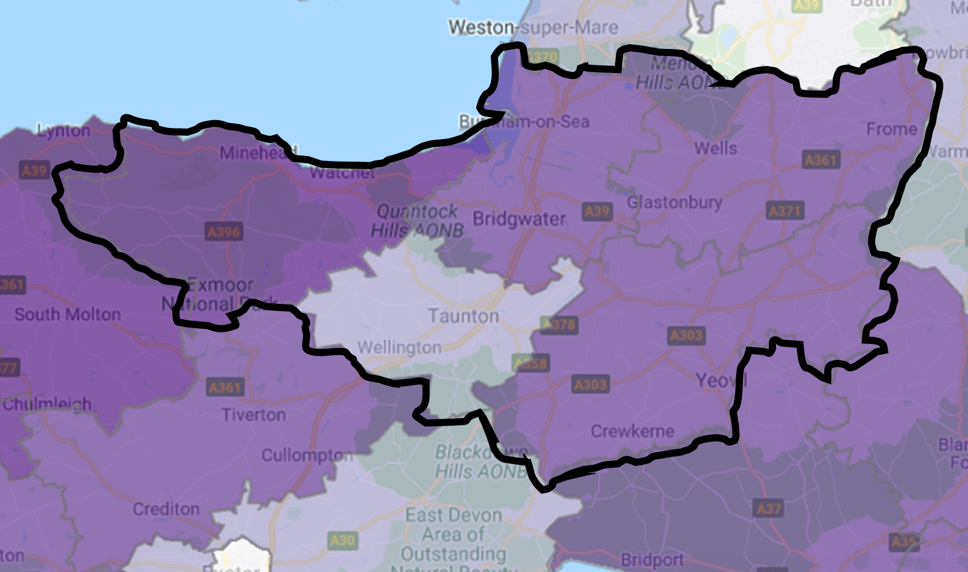
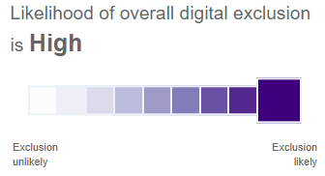
Somerset
High risk of digital exclusion
System redesign
Youth Net Outflow
Ageing Population
Notes:
No university etc

Slide 13
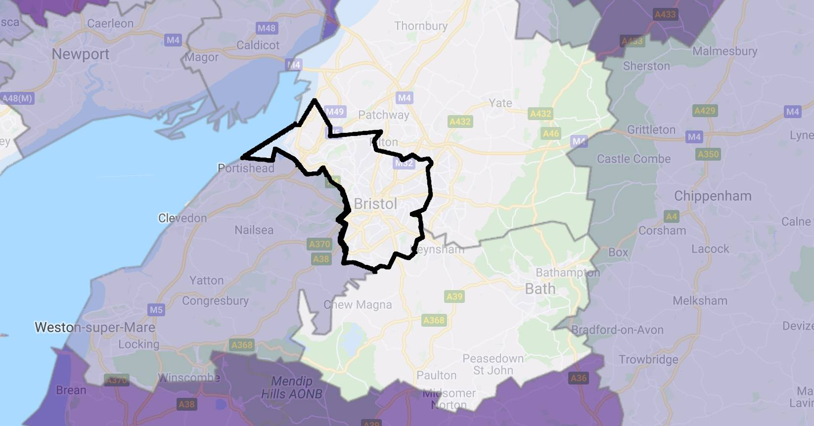
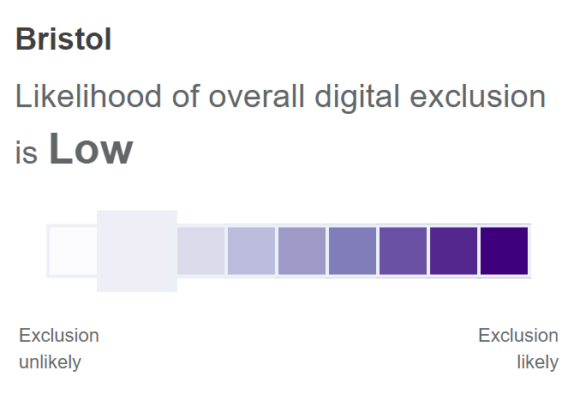
Somerset
High risk of digital exclusion
System redesign
Youth Net Outflow
Ageing Population
Notes:
No university etc

Slide 14
Somerset
Youth retention
System redesign
Youth Net Outflow
Ageing Population

Slide 15
Somerset: Helping to manage an ageing pop. through the Lens of Younger Generations
Youth Net Outflow
Youth retention
Ageing Population
System redesign

Slide 16
Somerset: Helping to manage an ageing pop. through the Lens of Younger Generations
Topol Review
90% of NHS jobs will need digital skills within 20 years
1
50% of NHS workforce will still be in the NHS in 15 years but their digital literacy is not a priority
2

Slide 17
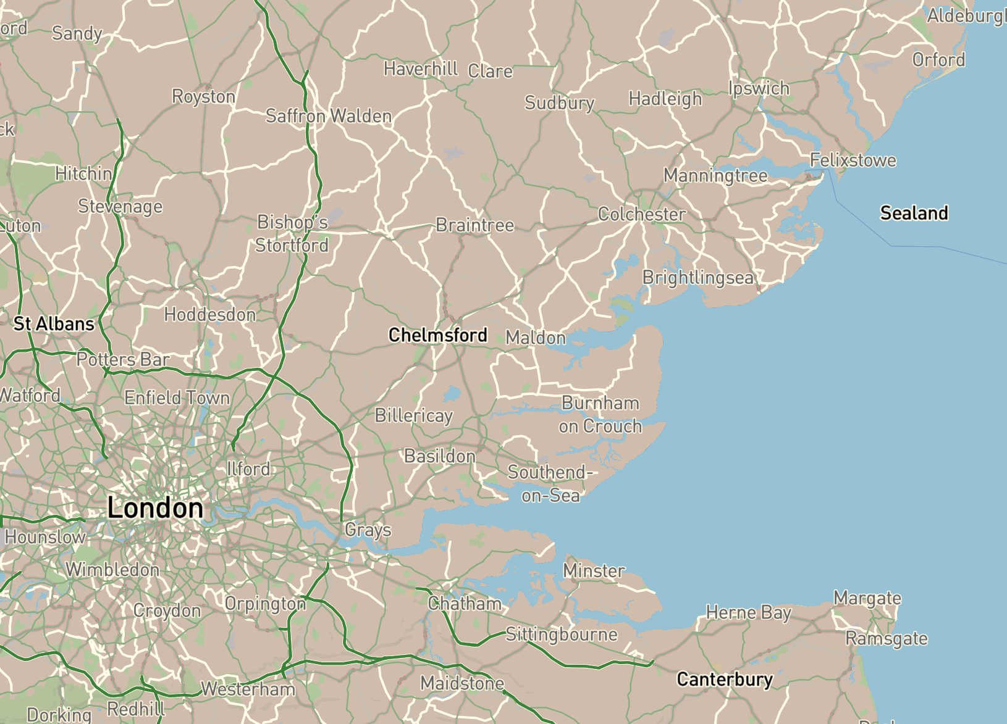
North East Essex
Suffolk & North East Essex ICS Population: 1m

Slide 18
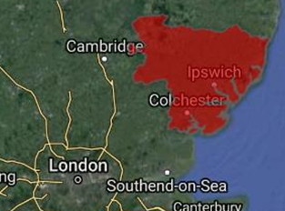
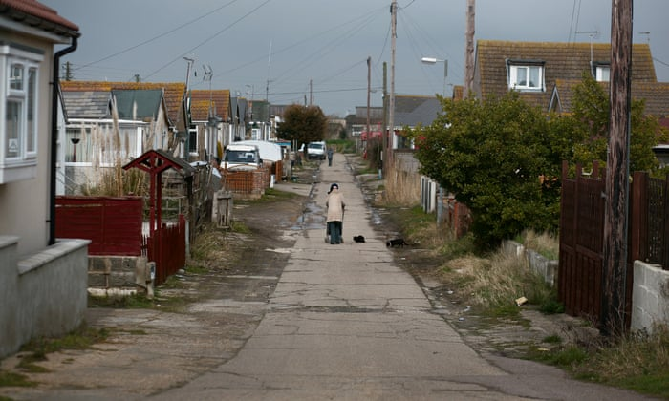
North East Essex
Suffolk & North East Essex ICS Population: 1m

Slide 19
North East Essex
1st
worst in unemployment
2nd
worst in educational attainment
10th
worst in child poverty

Slide 20
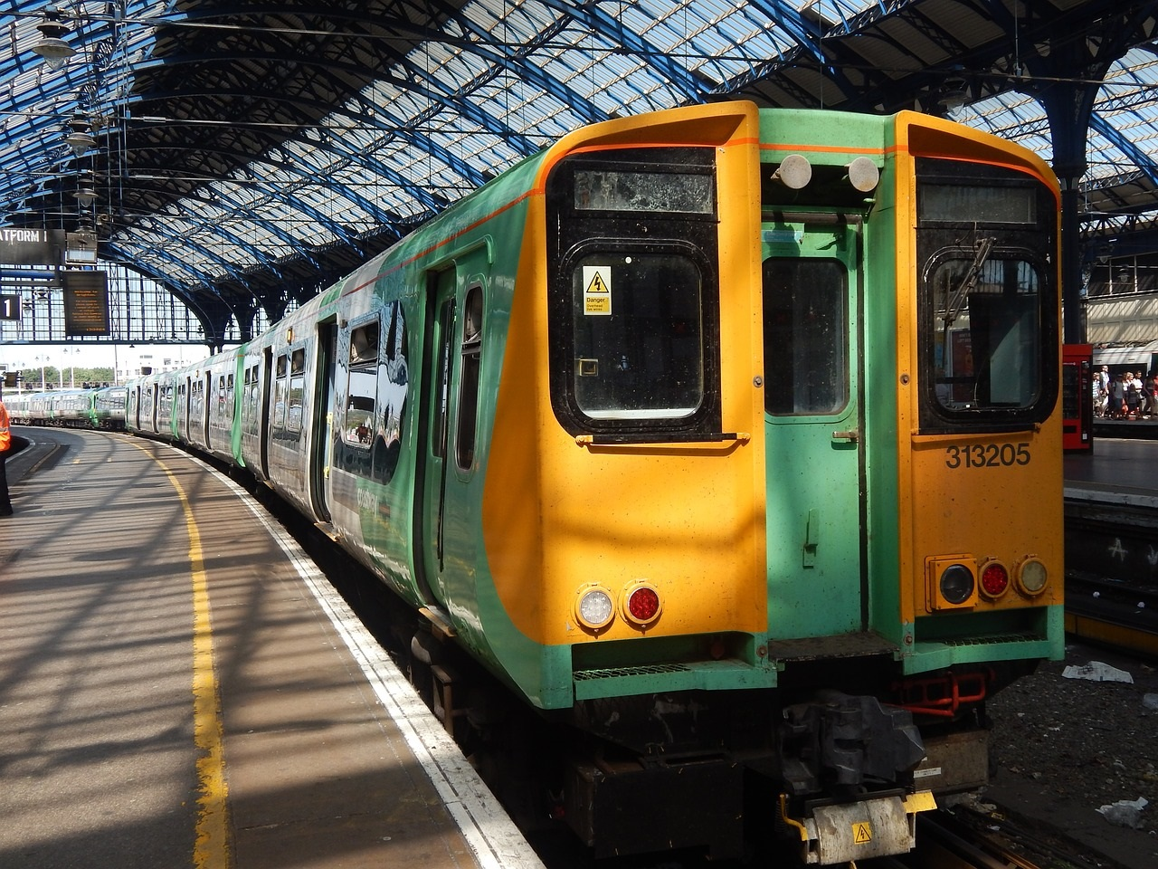
Housing
Education
Social Determinants of Health
Connectivity
Employment

Slide 21
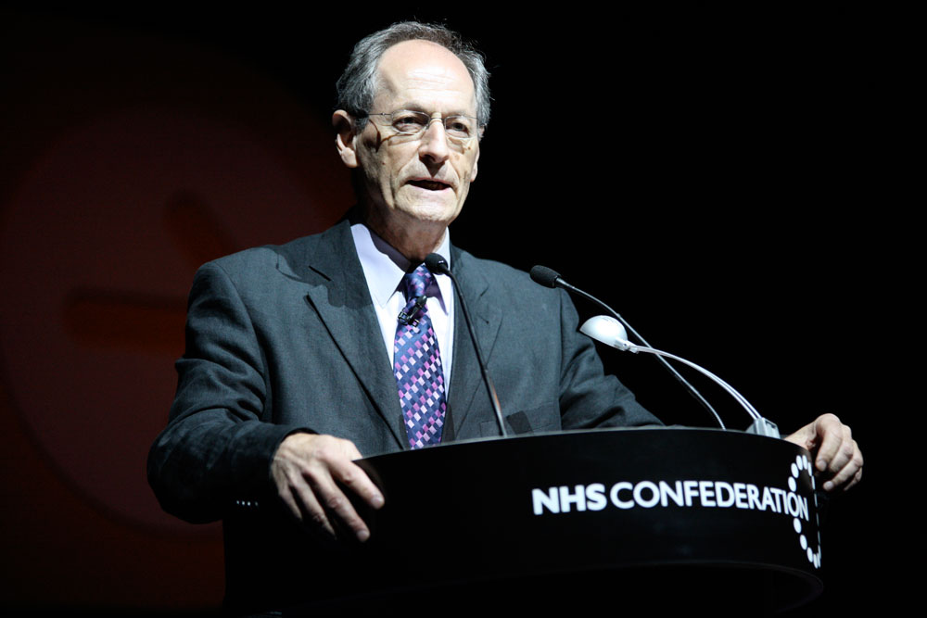
Social Determinants of Health
Professor Sir Michael Marmot
1
Create fair employment and good work for all
2
Ensure healthy standard of living for all
3
Create and develop healthy and sustainable places and communities

Slide 22
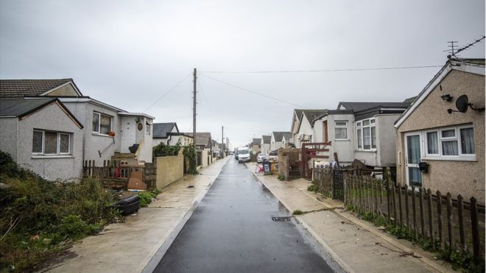
Industry & HE
University
SMEs
Government
MHCLG
DHSC
Local
ICS
Essex County

Slide 23
Need
Industry & HE
University
Business Case
Goal
1
A place to pioneer fresh policy ideas
SMEs
Joined up centre for training specific roles (e.g. prevention models)
Establishment of Clacton PLACE
New Prevention Models
2
Government
MHCLG
Patient-centric, practical policy feedback for personalised care
3
DHSC
ICS Long Term Plan
ICS
Local employment and economic regeneration
Local
1
Essex County

Slide 24
Lord Patel of Bradford
Mark
Ewins
Patrick Mitchell
Kate Davies CBE
Angela Halliday
Winter Review Panel

Slide 25
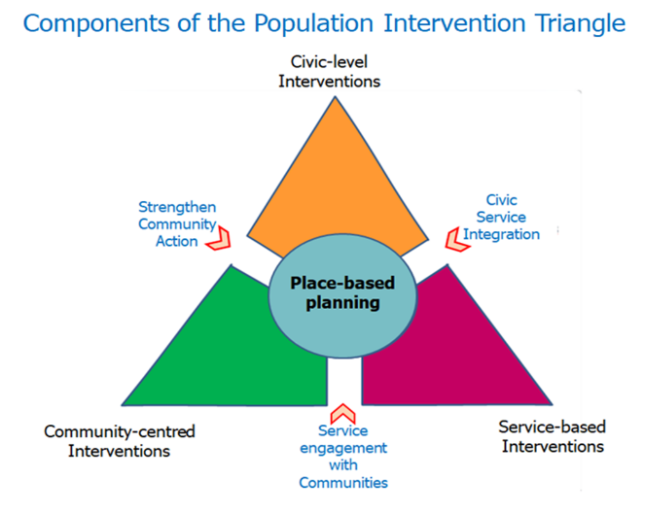
Placed Based Approaches to Reducing Health Inequalities

Slide 26
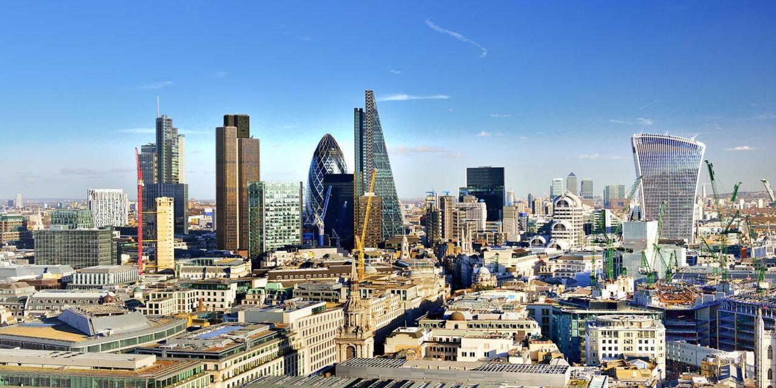
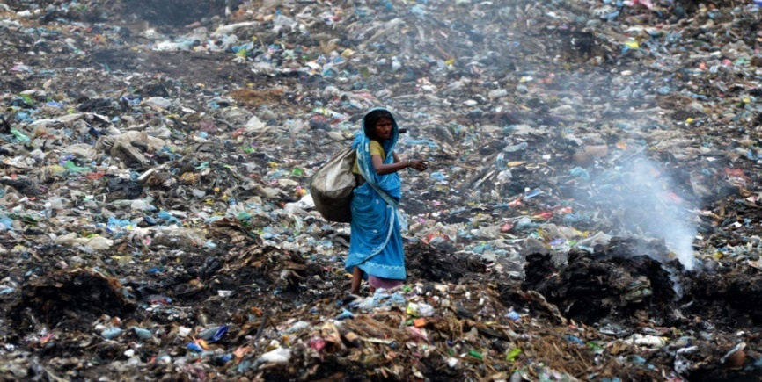
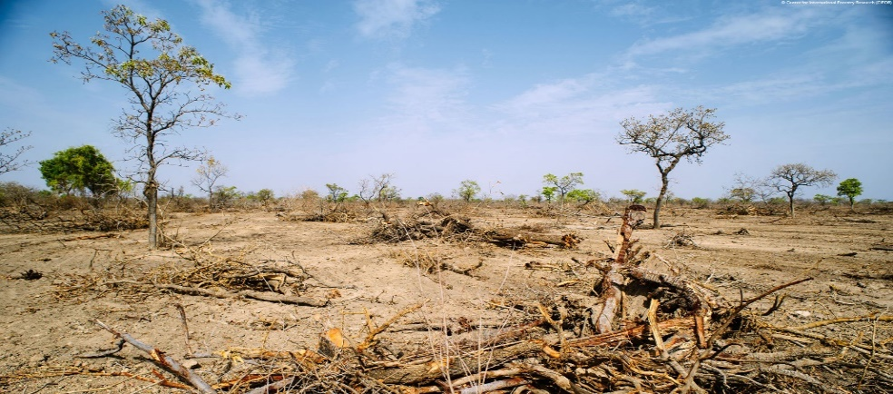
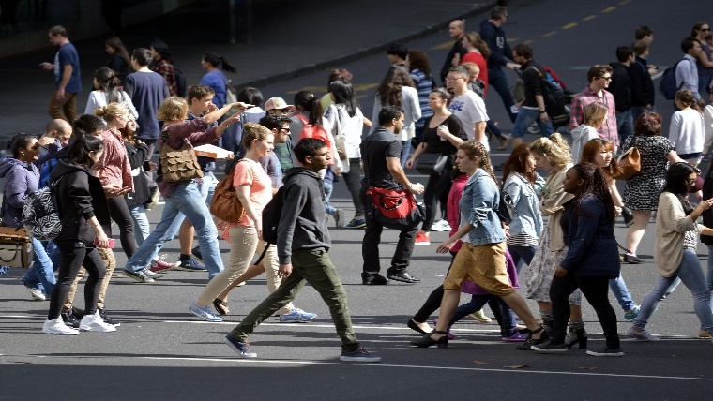
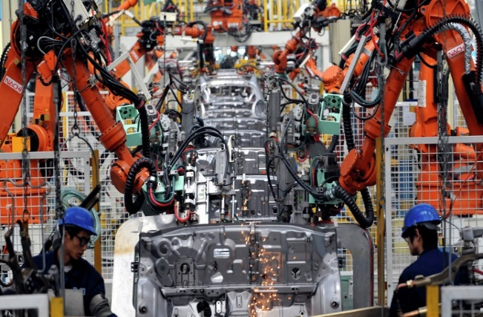
Quality of Life Services: Social Value in Action
BBI Winter Review – 7th November 2019
Angela Halliday, Director Social Impact UK&I

Slide 27
Sodexo – Leading from the front…
The end of the ROI-only era
“It is up to us to fully capture the social effects of economic growth, in order to benefit as many people as possible and ultimately to fight inequality. It is no longer the time to dream of another world. It is time to build one”
Denis Machuel, CEO of Sodexo
What our Senior
Leaders
are saying
“Angela’s appointment as Director, Social Impact UK&I reflects our ongoing commitment to transparency and achieving sustainable growth whilst remaining true to our mission – to improve quality of life wherever we operate”
“Social value is not optional”
Sean Haley, CEO Service Operations Worldwide & Region Chair, UK & Ireland
“We cannot think about success of organizations only through financial results but also through what they will bring to society”
Sophie Bellon, Chairman of the Board of Directors, Sodexo

Slide 28
Our Public Service Pledge: Focus on Outcomes not Outputs = Value
Create
capacity
First published in 2015 – one of the first companies to enter into meaningful dialogue with Government about social value
Sets out our ethical and sustainability commitments for our people, communities and customers in the UK&I
Commitments are over and above what our clients and customers expect from us
Our focus this year:
Providing value for money and achieve best possible outcomes for our clients
Demonstrate a public service ethos; how e deliver social value wherever we do business
Be a good employer
Environmental
Value for Money
Development
People
Collaborate
Communities
Health & Wellbeing
Vulnerable Groups
Cost effectiveness
Small businesses

Slide 29
Our Public Service Pledge: 18 Commitments
Help Government conduct early market engagement; providing insight into best practice
Independent contract satisfaction / expectation reviews
Abide by our Business Integrity Code
Deliver our Better tomorrow 2025 commitments
Employ 40 ex-offenders
Employ 200 ex-services personnel & their families
Prioritise partnering with SMEs/VCSES; INCREASING our SME spend to £200m by 2025
Recycle or re-use 70% our waste by 2020
Support Government’s childhood obesity plan
We promise to commit to, measure and report on - focus is on social as well as commercial aspects of contracts; using
National Social Value Framework (Themes, Outcomes & Measures – TOMs)
Follows Nolan’s seven principles of public life = Selflessness, Integrity, Objectivity, Honesty, Accountability,
Openness, Leadership
We believe that these principles combined with the missing principle ‘Efficiency’ provide value in delivery of public
services, and is underpinned by our UK Public Service Pledge

Slide 30
Our Public Service Pledge: Commitments
Double # employees volunteering to 2%
Increase women in our top 1,200 positions globally
Support ethnicity pay gap reporting
Maintain Disability Confident status
Support Good Work standards
850 employees as Apprentices
Implement Living Wage (where poss)
Managers complete mental health training
Work with professional bodies to assist in
developing better skills & capabilities for future FM
talent
Engaging Clients, our People and Communities – Social Value in Action…….

Slide 31
Thank you!
A number of Sodexo colleagues are here this evening & happy to discuss further…
Notes:
Almost 119 years to the date he died; nothing much has changed until now!
Social Value has risen to prominence recently, driven by legislation (Social Value Act, 2012), the reduction in central funding, and an increased focus on how the private sector can contribute to tackling societal challenges

Slide 32
To find out more about Sodexo and their Public Service Pledge visit UK.Sodexo.com
With Thanks to our Event Partners:

