Slide 1

Spring
Review
Supported by:

Slide 2

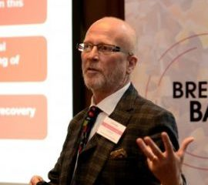
Agenda
1
Challenges
2
Solutions
Lord Patel of Bradford
3
Playbook
4
Future
Dr Jon Bashford

Slide 3
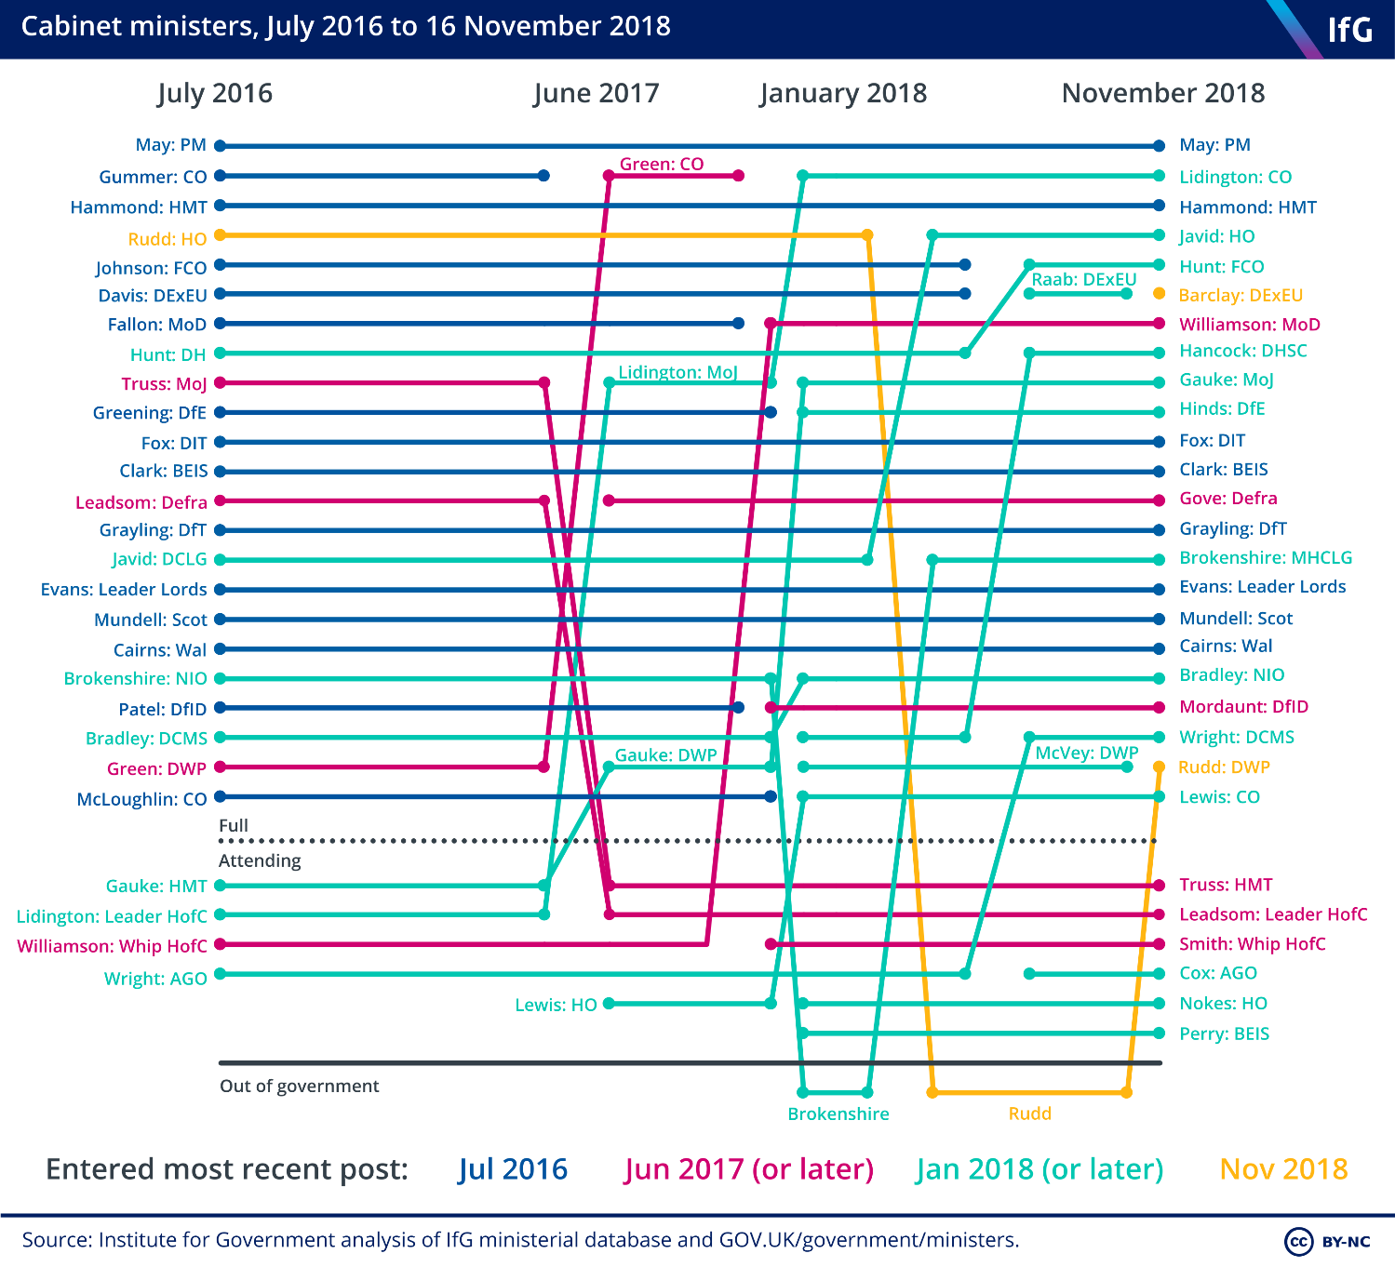
Top-down pilots
Centralised approach
UK has one of the most centralised governments, as measured by the proportion of revenue raised by sub-central government
Commission for Patient and Public Involvement in Health
(2003)
1
Health Action Zones
(1999)
8 Ministers for Housing in the last 9 years
2
3
59 initiatives from 1997 to 2016
Lack
of
consistency at the top
Total Place
(2009)
Only 5% of revenue is raised locally, as compared with 50% in Canada and 13% in France

Slide 4
Health and Social Care Overview
Challenges
Centralised approach
Money and demand
?

Slide 5
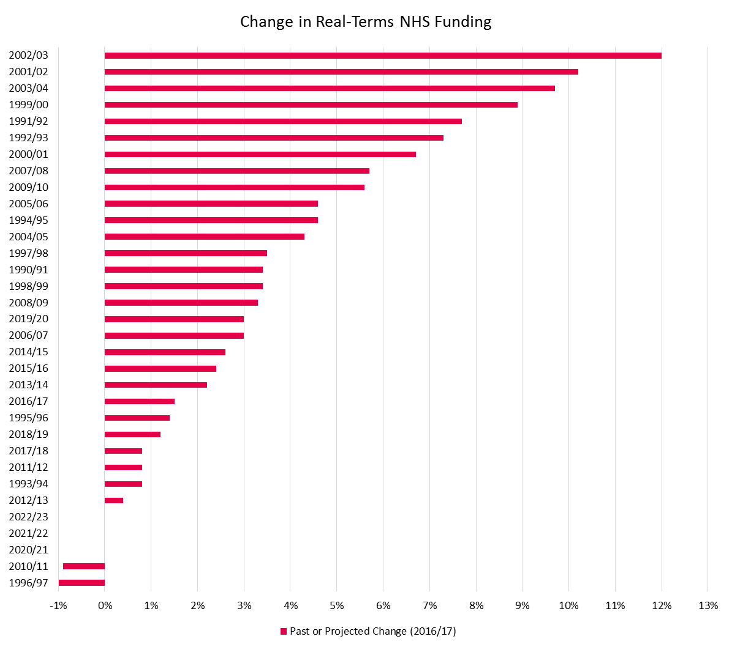
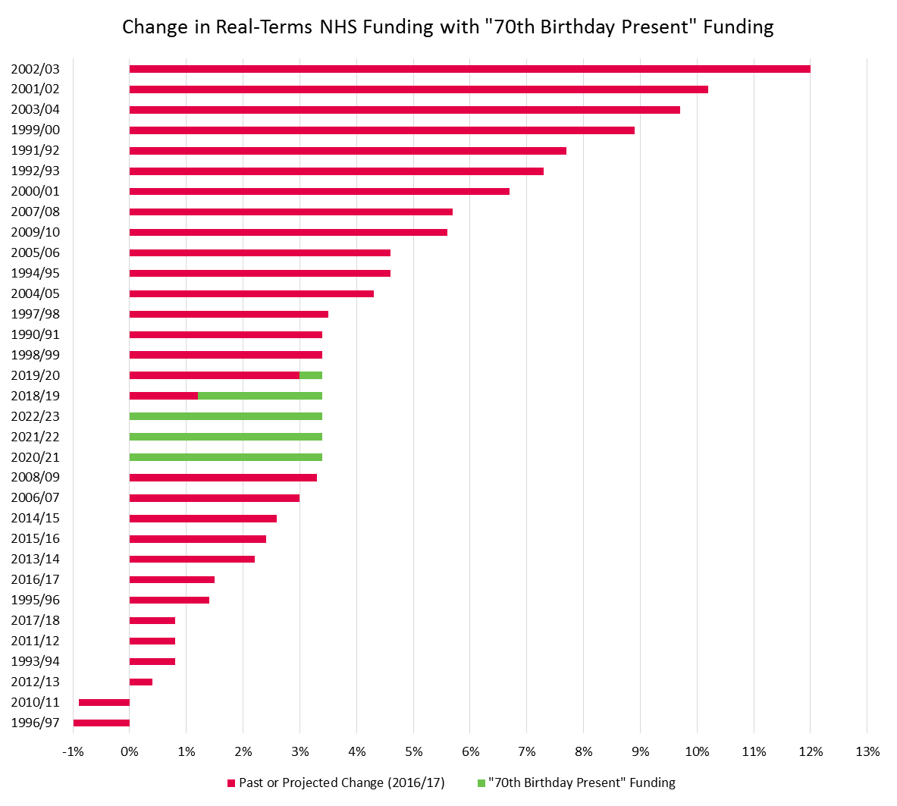
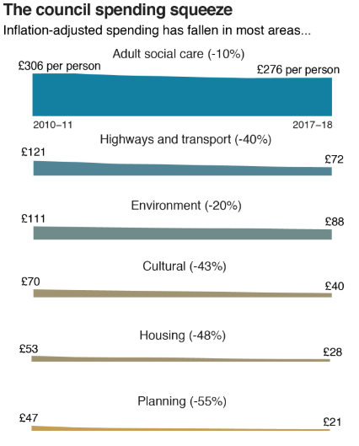
Money
NHS budget could top £200bn by 2030
Post-Pledge, funding will return to late-1990s levels (3.4%)
Prior to new funding pledge, NHS anticipating minimal growth in funding

Slide 6
Demand

Slide 7
Health and Social Care Overview
Challenges
Centralised approach
Way Forward
Money and demand
Integrated Systems
?

Slide 8

Integrated Systems
Integrated Care Systems all over England by April 2021
New service model in which patients get more options, better support, and properly joined-up care

Slide 9
Health and Social Care Overview
Challenges
Centralised approach
Way Forward
Money and demand
Integrated Systems
?
Prevention

Slide 10

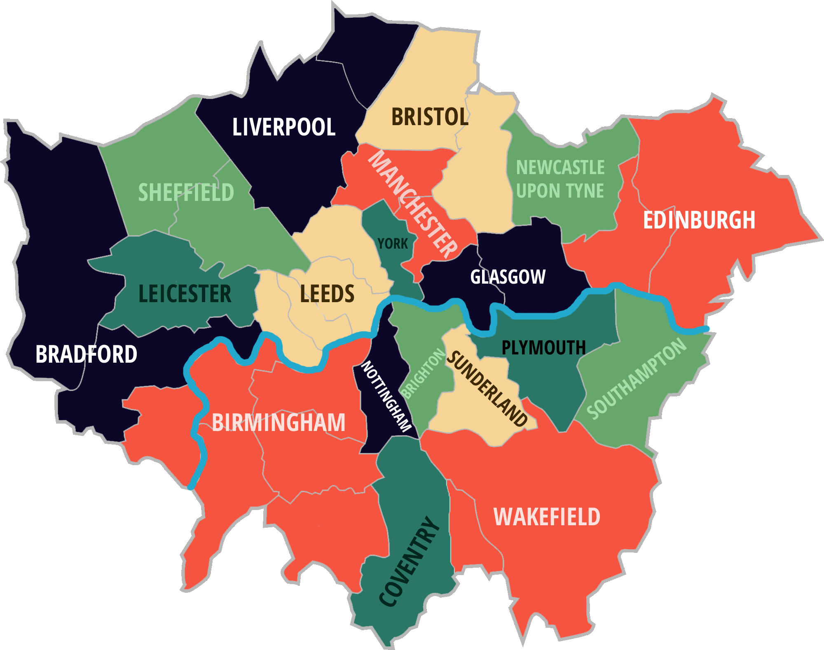
= 100,000
Ageing Society in 50 years time
=
8.6m more

Slide 11
Health and Social Care Overview
Challenges
Centralised approach
Way Forward
Money and demand
Integrated Systems
?
Prevention
Age friendly communities

Slide 12
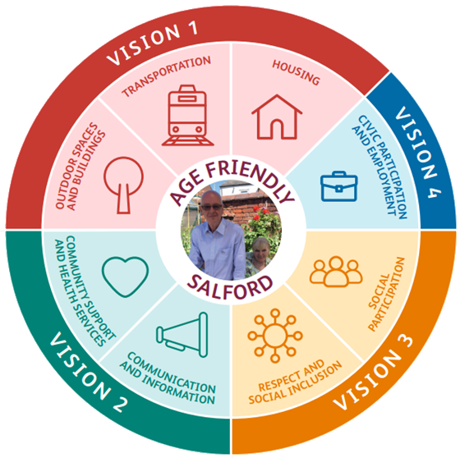
Age friendly communities
30% increase in people over 65 by 2039 in Salford
Rethinking housing, transport, and other services with the ageing population in mind

Slide 13
Health and Social Care Overview
Challenges
Centralised approach
Way Forward
Money and demand
Integrated Systems
?
Prevention
Age friendly communities
Workforce

Slide 14
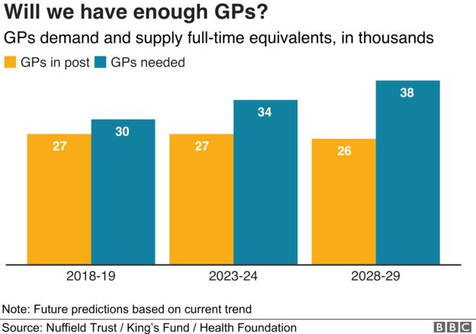
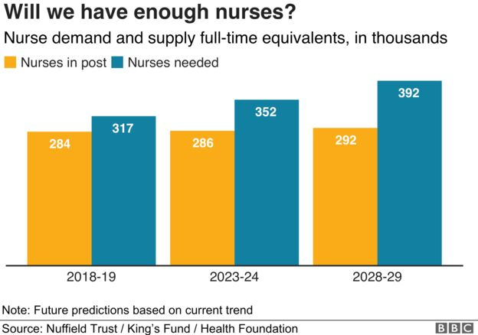
Workforce

Slide 15
Workforce
NHS workforce gap will grow to 250,000 over the next decade
400,000 social care workforce shortage predicted by 2028

Slide 16
Health and Social Care Overview
Challenges
Centralised approach
Way Forward
Money and demand
Integrated Systems
?
Prevention
Age friendly communities
Workforce
Competency /
skills & wellbeing

Slide 17

Competency / skills & wellbeing
Improving our leadership culture
Addressing urgent workforce shortages in nursing
Delivering 21st century care
A new operating model for workforce

Slide 18

Competency / skills & wellbeing
Competency Based Learning Health and Social Care Programme
1
2
3
Creates a career pathway from Apprentice to Registered Professional
Curriculum based on patient-centred care framework of standards
Developed with extensive input from employers, service users, and their families

Slide 19
Health and Social Care Overview
Challenges
Centralised approach
Way Forward
Project Applications
Money and demand
Integrated Systems
Innovative approaches & applications
?
Prevention
Age friendly communities
Workforce
Competency /
skills & wellbeing

Slide 20










BBI History
Launch of the Breaking Barriers Innovations Playbook
June 2016
February 2017
June 2017
March 2018
May 2018
September 2018
November 2018
April 2019
June 2019
June 2019

Slide 21
The Playbook
Stakeholders
Building Blocks
Barriers
Aims
The Goal
Local Government
NHS CCGs, Trusts & GPs
Short Term Priorities
Place-based approach that delivers
Housing Associations
No Blueprint
Residents & Third Sector
Different Systems
Education Providers
Siloed Budgets
Central Government
Fear & Risk of Failure
Social / Private Sector Housing

Slide 22




The Playbook
NHS Long Term
Plan (2019)
HEE Topol Review (2019)
Localism Act
(2011)
1
Sector Leaders
NHS CCGs
Health and Wellbeing Boards
Sustainability and Transformation Partnerships
Integrated Care Partnerships
Local Authorities
Strategic Alignment
2
Agree Dominant Strategy
1
Evidence-based, not ideological
3
Translation into culture and practice
4

Slide 23
The Playbook
Inclusion and empowerment
Resident & Community Engagement
1
Co-Design
2
Sustainability
2
Strategic Alignment
Community buy-in
Agree Dominant Strategy
1
3

Slide 24
The Playbook
Resident & Community Engagement
Co-Design
2
Recruitment and retention
1
Strategic Alignment
Learning networks /
cross-professional
2
Agree Dominant Strategy
1
Skills ladders and competency based learning
Workforce for the future
Skills, Competence, & Culture
3
3

Slide 25





The Playbook:
Action Plan
Co-designed with
service users
1
Resident & Community Engagement
Co-Design
2
Workforce and skills plan
2
Innovation and learning
from industry and CVS
Strategic Alignment
3
Agree Dominant Strategy
1
Workforce for the future
Skills, Competence, & Culture
Affordable & sustainable
4
3
Service Integration
Service Transformation
Governance route map
4
5

Slide 26





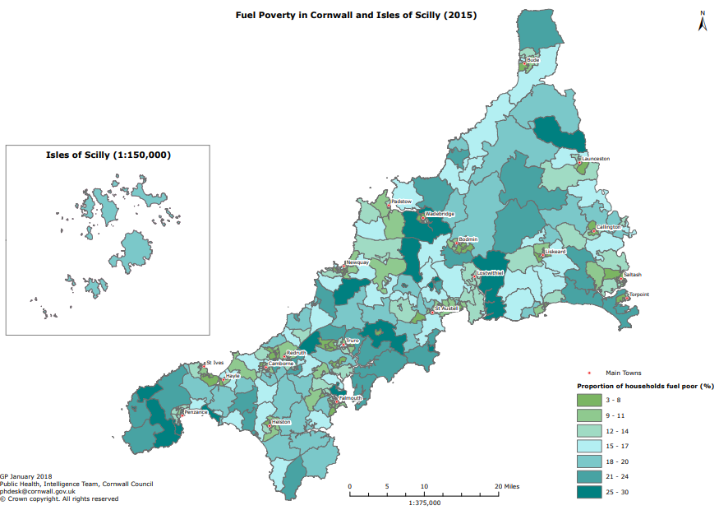
Project 1: Cornwall
How to equip the workforce to operate across health and social care, and residential settings?
Partners:
Fuel Poverty
By 2036, over a third of the population will be over 65
65 mins to nearest hospital by public transport
36% of the population are active volunteers
Cornwall suffers two seasonal spikes – Winter and Summer

Slide 27
Project 1: Cornwall
How to equip the workforce to operate across health and social care, and residential settings

Slide 28





Project 2: Portsmouth
Partners:

Slide 29
Project 2: Portsmouth
How to adopt a family first approach to approach social isolation and loneliness?

Slide 30


Going Forward
First Action Plans released
8 additional locations coming on stream
Thinking it Through - Veterans

Slide 31
Challenges
Money and demand
Prevention
Workforce

Slide 32




Panel Discussion
Patrick Mitchell
(HEE)
Andrew Mindenhall
(Agilisys)
Shirley Cramer
(Royal Society for Public Health)

Slide 33
Spring
Review
Supported by:

