Slide 1
Clacton Place & Health Inequalities

Slide 2
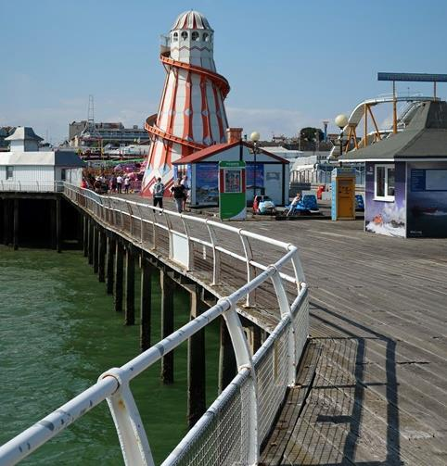
Agenda
1
2
3
Challenges
Anchor Opportunities
Our next 12 months

Slide 3
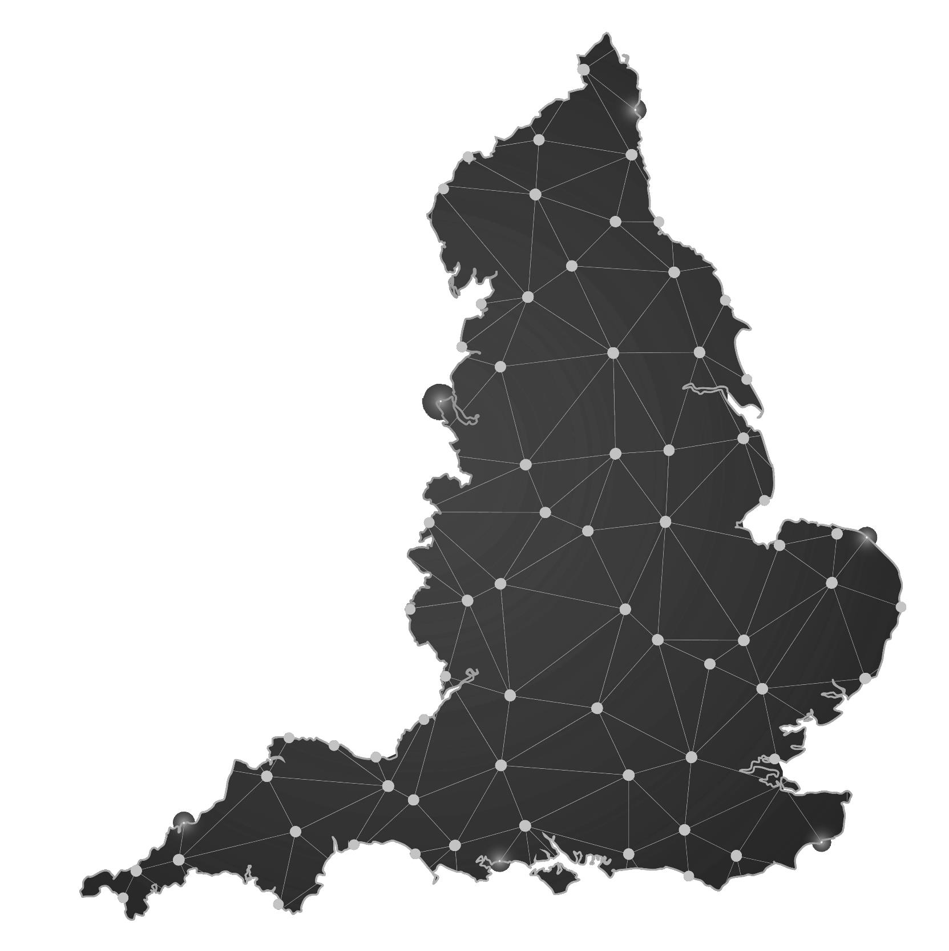
1
Challenges
3
Our next 12 months
2
Anchor Opportunities

Slide 4
1
Challenges

Slide 5
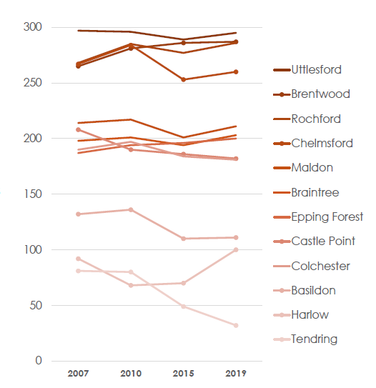
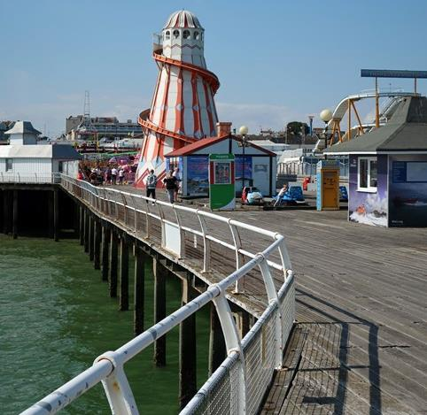
Challenges
Tendring saw the third largest decline in public health stats from 2010-15, continuing apace through 2015-19

Slide 6
Challenges
26% have a long-term limiting illness or disability
27% are aged 65 or over.
Life expectancy is over 2 years lower than rest of region
Jaywick has up to 50% unemployment recorded
64% of working age people are in employment
23% children in Tendring are in low income families

Slide 7
1
Challenges
Clacton
London

Slide 8
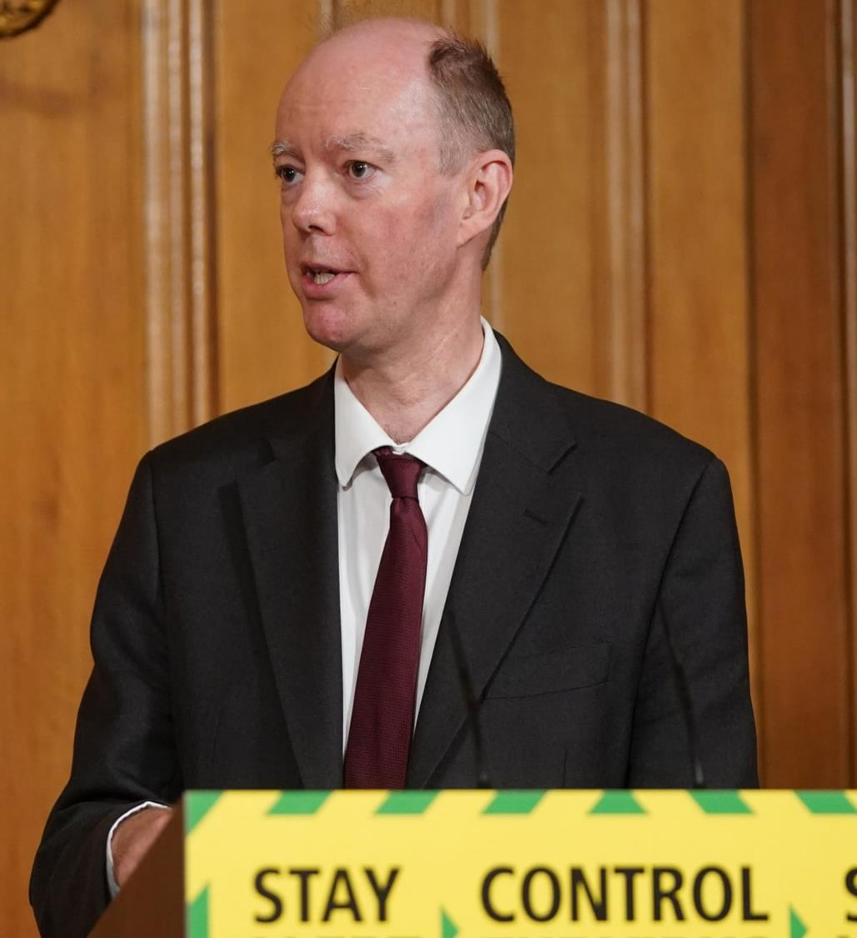
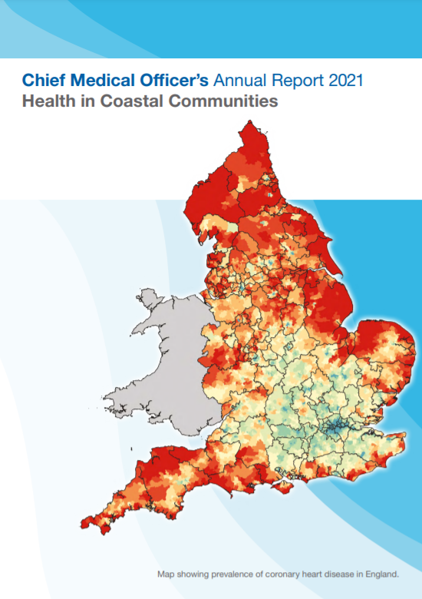
Clacton in the National Spotlight
“Overwhelmingly the
most important
challenge in Clacton is
attracting quality jobs”
The Vision: The ultimate vision is to restore Clacton to a thriving community where young people and families have the educational and employment opportunities that encourage them to settle and remain in this attractive and historically important part of Essex.

Slide 9
Place to address health inequalities
Build Back Better
Population healthcare in coastal towns
Clacton Place
CMO Report
Sharing prosperity
Levelling Up
Opportunities they present to reverse inequalities
Orgs rooted in place

Slide 10
Clacton Place: Health inequalities & Employment
Tools and measures
Restore services inclusively
A representative and diverse workforce
Programme actions
WRES, WDES, SOM
Culturally appropriate and sensitive care
Lived experience engagement
EDS
Mitigate against digital exclusion
Health & Care Academy – digital training
Peer research
Enrolment & Completions
Care sector digital parity and maturity
EDS
Health & Care Academy
Ensure datasets are timely and complete
Social informatics
JSNA
Anchor clusters: Health and Care, Ports & Logistics, Green economy
Lived experience peer research
BBI LE Programme
Accelerate Preventative programmes
Early employment and skills support
DWP
Multi-Disciplinary Team – Health and DWP
Co-production model
MDT
Leadership & Accountability
Integrated Care System
Governance
Equity Dashboard
New ecosystem for co-production
Learning & Dissemination
Advance planning

Slide 11
Setting scene for Clacton Place
Of the estimated number of people with Diabetes…
This means that only 6% of people with Diabetes live a life free from Diabetes related complications
Social and cultural domain – completely unaware of problem
About 50% are diagnosed
Bio-social domain – has diagnosis but not managing well
Of whom 50% receive care
Of whom 50% achieve treatment target
Of whom 50% achieve treatment target
Biomedical domain – managed care
Napier (2019): The Rule of Halves and its role in preventing, managing and treating diabetes
Notes:
Source: Napier (2019) - The Rule of Halves and its role in preventing, managing, and treating diabetes.

Slide 12
Setting scene for Clacton Place
Domain
Intervention
Evidence
Social and cultural domain – completely unaware of problem
Education and awareness, public health campaigns, targeted communications at population levels
Weak – tends not to reach those most in need, hard to determine results
Social protections – employment, food security, housing
Outreach and advocacy
Community engagement
Bio-social domain – has diagnosis but not managing well
Strong – Social Determinants of Health have greater impact on health inequalities
Social prescribing, cultural competence, personalised medicine
Weak – factors in previous domain remain strongest association with outcomes
Biomedical domain – managed care

Slide 13
1
Challenges
3
Our next 12 months
2
Anchor Opportunities

Slide 14
2
Anchor Opportunities

Slide 15
Freeport East
Colchester
Transforming Care & CareTech
Tendring & Colchester Borders Garden Community
Levelling Up
Health & care Academy
Clean Energy & Nuclear

Slide 16
Anchor Opportunities
Freeport East
£500m investment
GVA of +£5.5bn over 10 years
13,500 new jobs
Massive employment opportunities but skills development for local resident must commence now

Slide 17
Anchor Opportunities
Health & Care Academy
Reskilling for senior cohorts
Interventions for younger cohorts
Providing opportunities
Skills that can support health and social care but that are transferable to other sectors

Slide 18
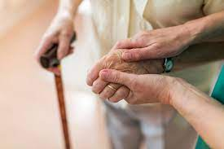
Anchor Opportunities
Transforming Care & CareTech
Digital social care records take up at 40%
7,000 employees
30.4% staff turnover
Lockdown has highlighted the important role digital can play in supporting the care environment
North East Essex is developing a CareTech hub to accelerate this and support economic growth

Slide 19
Anchor Opportunities
Green Economy
25,000 nuclear construction jobs
3,478 new jobs in offshore wind
1,000 apprenticeships
Critical mass of clean energy projects being developed locally
Fears that these jobs may not be accessed by local residents
Loss of farming subsidies and shift to carbon neutrality is key for farming & forestry

Slide 20
Anchor Opportunities
Tendring & Colchester Borders Garden Community
7 hectares of employment land
Strong links with infrastructure hubs
2,200 – 2,500 new homes
The Garden Community has the opportunity to perform at a local, regional, national, European and even global scale – both physically and digitally

Slide 21
Anchor Opportunities
Levelling Up & Anchor Influence
50% of HQs still in London
22,000 staff to be relocated from London
Civil Service Employs 450,000 FTEs
The UK Government has a programme of Levelling Up to bring policy and power closer to the communities it serves

Slide 22
Anchor Opportunities at a glance
Opportunity
Roles
Key Issue
Clean Energy & Nuclear
Construction
Ensuring all local residents can take advantage of opportunities
Transforming Care & CareTech
Digital
Care roles
Freeport East
Logistics
Health & Care Academy
Project management
Levelling Up

Slide 23
1
Challenges
3
Our next 12 months
2
Anchor Opportunities

Slide 24
3
Our next 12 months

Slide 25
Clacton Place
Health inequalities
Lived experience
Suffolk & North East Essex ICS
Anchor employment
Skills
Notes:
25

Slide 26
Our Next 12 Months
1
2
3
Phase 1: System alignment
Phase 2: Lived experience programme and co-production with anchors
Phase 3: National Learning & Future Policy Considerations
November 2021 – January 2022
February – August 2022
September – October 2022

Slide 27
Phase 1: System alignment
ACTIONS
OBJECTIVES
1
Data evaluation
Define inequality groups
Engage CVS partners
Recruit peer researchers
Framework design
Academy strategy development
Anchor employer engagement
Governance and project management
2
CVS engagement – sign up
3
Co-production framework
4
Evaluation metrics
5
Regional anchor programme
6
Steering Group
TIME – 2 months

Slide 28
Phase 2: Lived experience programme
ACTIONS
OBJECTIVES
1
Training
Capacity building for each cohort
Building the lived experience evidence base
Co-production workshops – employers, skills and CVS
Evaluation reports inform adaptations in programme
2
Individual employment and skills support
3
Peer research
4
Co-production
5
Skills pipelines
6
Advance planning ecosystem with anchors
TIME – 8 months

Slide 29
Phase 3: National learning
ACTIONS
OBJECTIVES
Lessons learned
National, local and system policy and planning considerations
Action plan for change
Ensure sustainability of dialogue and engagement
1
Final analysis and reports
2
Regional launch events
3
National report launch
4
Health Anchors Network Event
TIME – 2 months

Slide 30
The Difference we want to make: year 1
1
Establish pipeline of good quality, sustainable jobs from anchor clusters that will act as catalyst for change
2
Informed by 300-500 residents how these opportunities can be made accessible to all population health groups
3
Secure employment and/or training opportunities for the 50 peer researchers
4
Sustain through Place and Community informed investment in Health and Care Academy

