Slide 1





A place for prevention
Background and context for the Kent Action Plan

Slide 2

This presentation contains animations so please view this in full screen mode.
If you wish to see a static presentation, please email george.evans-jones@bbi.uk.com

Slide 3
The Playbook
Stakeholders
Building Blocks
Barriers
Aims
The Goal
Local Government
NHS CCGs, Trusts & GPs
Short Term Priorities
Place-based approach that delivers
Housing Associations
No Blueprint
Residents & Third Sector
Different Systems
Education Providers
Siloed Budgets
Central Government
Fear & Risk of Failure
Social / Private Sector Housing

Slide 4


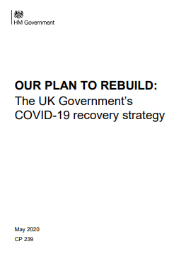
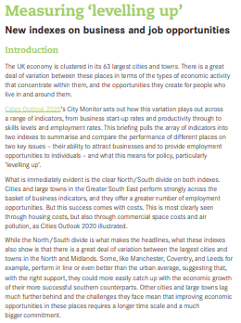
The Playbook
NHS Long Term
Plan (2019)
HEE Topol Review (2019)
Covid Recovery
plan
Levelling up
strategy
1
Sector Leaders
NHS CCGs
Health and Wellbeing Boards
Sustainability and Transformation Partnerships
Integrated Care Partnerships
Local Authorities
Strategic Alignment
2
Agree Dominant Strategy
1
Evidence-based, not ideological
3
Translation into culture and practice
4

Slide 5
The Playbook
Strategic Alignment
Agree Dominant Strategy
1

Slide 6
The Playbook
Inclusion and empowerment
Resident & Community Engagement
1
Co-Design
2
Sustainability
2
Strategic Alignment
Community support
Agree Dominant Strategy
1
3

Slide 7
The Playbook
Resident & Community Engagement
Co-Design
2
Strategic Alignment
Agree Dominant Strategy
1

Slide 8
The Playbook
Resident & Community Engagement
Co-Design
2
Recruitment and retention
1
Strategic Alignment
Learning networks /
cross-professional
2
Agree Dominant Strategy
1
Skills ladders and competency based learning
Workforce for the future
Skills, Competence, & Culture
3
3

Slide 9
The Playbook
Resident & Community Engagement
Co-Design
2
Strategic Alignment
Agree Dominant Strategy
1
Workforce for the future
Skills, Competence, & Culture
3

Slide 10





The Playbook
Action Plan
Co-designed with
service users
1
Resident & Community Engagement
Co-Design
2
Workforce and skills plan
2
Innovation and learning
from industry and CVS
Strategic Alignment
3
Agree Dominant Strategy
1
Workforce for the future
Skills, Competence, & Culture
Affordable & sustainable
4
3
Service Integration
Service Transformation
Governance route map
4
5

Slide 11
The Playbook
Resident & Community Engagement
Co-Design
2
Strategic Alignment
Agree Dominant Strategy
1
Workforce for the future
Skills, Competence, & Culture
3
Service Integration
Service Transformation
4

Slide 12
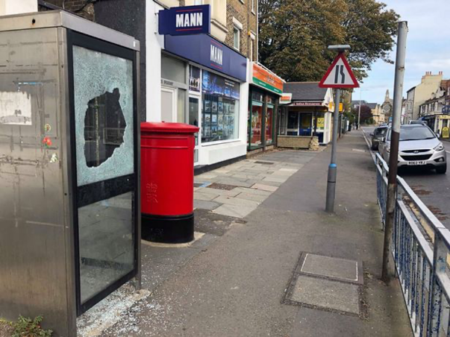
System Challenge

Slide 13

The cost of not addressing deprivation
In Kent £111m additional costs are associated with variations in deprivation
This is 15% of all health and social care costs for people aged over 55
The largest burden is in secondary care and social care
Jayatungaa W, Asaria M, Bellonic A, George A. (2019) Social gradients in health and social care costs: Analysis of linked electronic health records in Kent, UK. Public Health. 2019; 169; 188-194

Slide 14
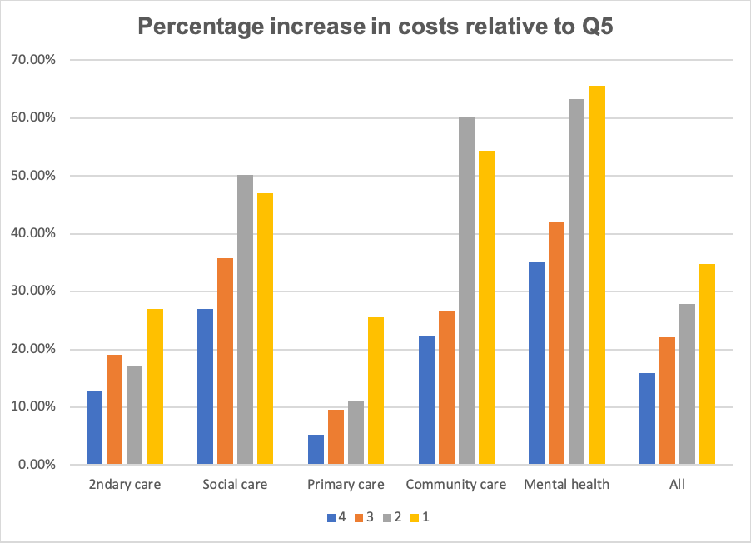
The cost of not addressing deprivation
The gradient is:
66% higher for mental health
54% higher for community care
47% higher for social care
Interventions are not targeted by social determinants
More affluent populations benefit most from prevention
Jayatungaa W, Asaria M, Bellonic A, George A. (2019) Social gradients in health and social care costs: Analysis of linked electronic health records in Kent, UK. Public Health. 2019; 169; 188-194

Slide 15


Kent Playbook Stakeholder observation
“We are trying to stop people falling off the cliff…”
Prevention for marginalised population groups
“…when what we should be doing is helping them walk down the hill”

Slide 16

Understanding the focus
1
System consensus and scale
In order to change the emphasis we need to focus on three things:
2
Marginalised population groups
3
Understanding prevention

Slide 17
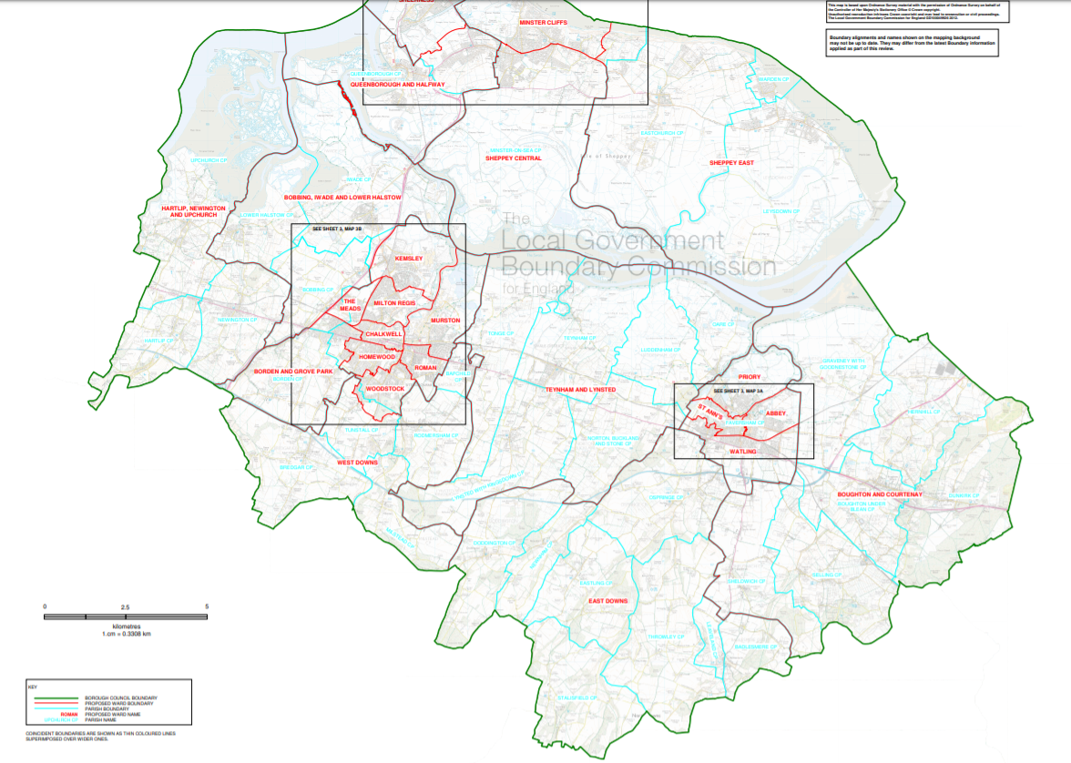
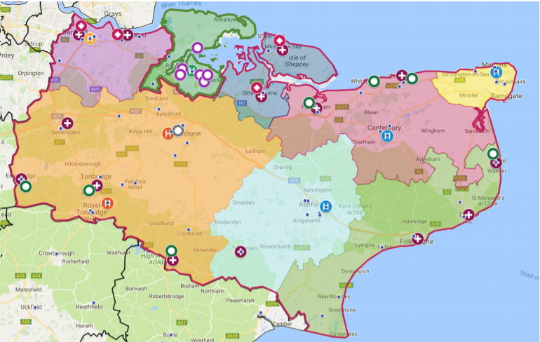

1
Focus on prevention- at what level?
Parish/neighborhood scale: Where prevention happens but gaps in capacity and availability of required skills
District Scale: Insufficient focus- but critical player for interventions
STP/county scale: Focus is too high level

Slide 18
2
Marginalised population groups
What do we mean by marginalised population groups?
Takes many forms, and these may not always be apparent
Formal and informal
Traditional typology
Situated in time and place
Lived experience (internalised)

Slide 19
2
Marginalised population groups
Characteristics
Capacities
Access to Resources
Socially isolated
e.g. Lonely; living alone; unemployed
e.g. Limited social network; physical distance from family
e.g. home ownership, cash poor – mainly over 55
Working poor
e.g. Young families; single parents
e.g. Reliance on close family and friends; limited travel capacity
e.g. Limited access to leisure, holidays etc.; use of food banks
Physical disabled
e.g. Visual and auditory impairment
e.g. Limited mobility; high communication needs
e.g. Restricted or inappropriate service access; dependent on benefits;

Slide 20
2
Marginalised population groups
Characteristics
Capacities
Access to Resources
Mental illness
e.g. Socially isolated; highly medicated
e.g. Under employment; stress at work
e.g. High levels of primary and urgent care use; experience of stigma
Socially vulnerable
e.g. Frail elderly; victims of sexual assault and domestic violence
e.g. Early childhood trauma manifesting in adult life; contact with the criminal justice system;
e.g. Failure to meet service access thresholds
BAME
e.g. Diverse and heterogenous; marginalisation linked to prejudice
e.g. Faith and culture; close family and neighbourhood ties
e.g. Acculturation; experience of racism and discrimination; unemployment

Slide 21
2
Marginalised population groups
Formal Marginalisation
Socially isolated
Working poor
An Approach using Informal Marginalisation related to people’s lived experience
Mental illness
BAME
Physically disability
Socially vulnerable

Slide 22

3
How do we understand prevention?
Context:
Interventions
Obesity and Physical Activity
Smoking cessation
1,600 local people are estimated to die every year from causes considered amenable to healthcare
Workplace health
Reduce alcohol-related harms

Slide 23

3
How should we understand prevention?
Context:
Interventions
Proportionate universalism
Social determinants of health
Community empowerment
The Marmot Review 10 Years On found health inequalities are widening
Inclusive economies

Slide 24



Sustainability Issues
Existing System Approach
System Challenge

Slide 25
Challenges
Spatial planning that:
prioritises reliable and affordable public transport
incentivises support to increase walking and cycling
will result in greater inclusion, protect the environment, support the economy and improve health and wellbeing.
Sustainability Issues
Transport
“Transport is irregular and unreliable; it makes it difficult for the services to reach people – can’t get them in.”
(VCSE respondent)

Slide 26
Challenges
Austerity has three impacts:
Uplift in access criteria
Increase in the experience of marginalisation resulting from exclusion from or limited access to services.
Rise in the complexity and needs of service users accessing VCSE respondent services (not included in historical commissioning arrangements.
Sustainability Issues
Transport
Service access
“You can be left feeling cut off, people are only being seen by the mental health service if they are in crisis, just because you’re not in crisis doesn’t mean you don’t need help.” (Service user respondent)

Slide 27
Challenges
Covid-19 and the differential impacts by gender and ethnicity
Some BAME groups have around twice the risk of death when compared to people of White British ethnicity.
All-cause mortality was almost 4 times higher than expected among Black males for this period, almost 3 times higher in Asian males and almost 2 times higher in White males.
Sustainability Issues
Transport
Service access
Differential impact
How people experience place is very localised, it operates at the level of the street and neighbourhood

Slide 28
Challenges
Sustainability Issues
Transport
Service access
BBI focussed its analysis on two wards. The more urban Northfleet and the more rural Isle of Sheppey
Differential impact
Local impact
Marginalisation in place
Marginalisation in people

Slide 29
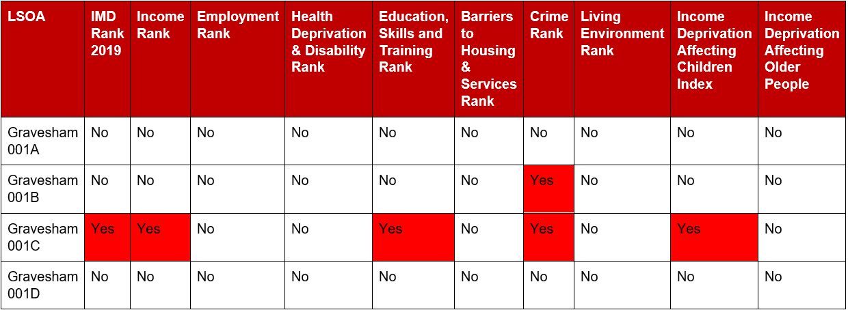
Local impact: Marginalisation in place
Northfleet North (2019)

Slide 30
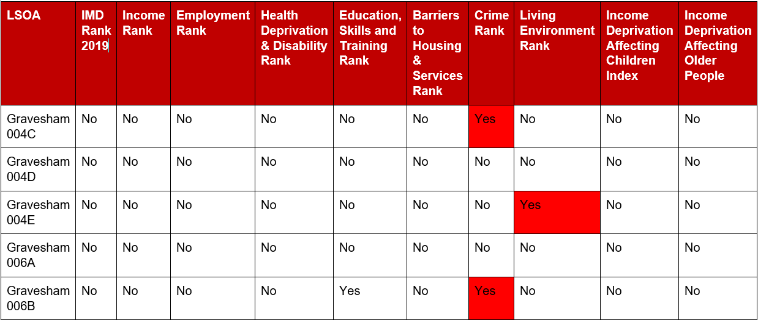
Local Impact:
Marginalisation in place
Northfleet South (2019)

Slide 31
Local Impact:
Marginalisation in place
Ethnicity
Important variations in ethnic breakdown in Northfleet, an area with a much higher density of BAME population groups

Slide 32
Local Impact:
Marginalisation in place
Economic disadvantage
Swale has the second highest number of LSOAs to remain with the 10% most deprived
Two wards in Swale have moved to within the most deprived decile from 2015-2019

Slide 33
Local Impact:
Marginalisation in place
Income deprivation
Sheppey East has the highest % of those claiming UC while not being in employment

Slide 34
Local Impact:
Marginalisation in place
Caring
37.8% of carers in Sheerness are providing 50 hours or more of unpaid care per week
It is the younger people of working age who are bearing the brunt of this

Slide 35

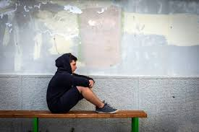

Local Impact:
Marginalisation in people
Poor service experience affects a person’s willingness to engage in the future before a ‘crisis’ point
Trust
People feel discriminated against on basis of place
Exclusion
Internalised stigma and discrimination can result in people being more withdrawn and less willing to engage
Stigma

Slide 36
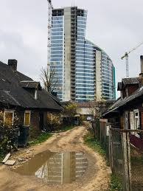
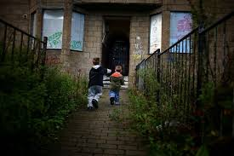
Local Impact:
Marginalisation in people
Protected characteristics remain significant factors in marginalisation
Disparities
Struggling at the margins – food, transport and access to services
Poverty

Slide 37
Summary
1
Prevention needs to be viewed from a highly localised level
Achieving consensus on definitions of prevention and marginalisation is important for the system to be able to operate at a place based level
2
Marginalisation is too complex to be defined in ‘formal’ terms
3
4
Community engagement and co-production are key to embedding this approach – not just a one off project

